Slide 1
MEng Orientation
Winter 2024
January 12, 2024

Slide 2
Land Acknowledgement
We wish to acknowledge this land on which the University of Toronto operates. For thousands of years it has been the traditional land of the Huron-Wendat, the Seneca, and the Mississaugas of the Credit. Today, this meeting place is still the home to many Indigenous people from across Turtle Island and we are grateful to have the opportunity to work on this land.

Slide 3
Agenda
Welcome – Professor Markus Bussmann
Welcome to the MEng program – Professor Kamran Behdinan, Professor Janet Lam
MEng program details & requirements – Carla Baptista & Sandra Borges
MEng projects - Professor Kamran Behdinan
MIE Graduate programs & supports – Carla Baptista
Graduate Professional Development Initiatives Video - Joanne Lieu
MIE Community And supports – Kendra Hunter
Q&A
Networking

Slide 4
Professor Markus Bussmann
Professor Tobin Filleter
Department Chair
Associate Chair of Graduate Studies

Slide 5
Professor Kamran Behdinan
Professor Janet Lam
MEng Academic Advisor, Industrial Engineering
Academic Director - Professional Program
& MEng Academic Advisor, Mechanical Engineering

Slide 6
Graduate Office Support Staff
Carla Baptista, Manager, Academic Programs
Oversee the Graduate and Undergraduate Academic Programs and Offices
MEng student support & adviser
Program & Course related questions
carla@mie.utoronto.ca
Sandra Borges, Graduate Program Advisor
PhD/MASc admissions, student advising and support
Program & Course related questions
PhD annual milestones/ meetings and exams
Sandra.borges@utoronto.ca
Leila, Graduate Office Assistant (Acting)
Front-line advising
Graduate Student Support
gradoffice@mie.utoronto.ca

Slide 7
MIE Graduate Programs
The Department of Mechanical & Industrial Engineering offers three graduate programs:
Professional Master of Engineering (MEng) program
Research-based Master of Applied Science (MASc)
Doctor of Philosophy (PhD) programs

Slide 8
Graduate Office Services (MC108)
Academic Advice
Course enrollment & course selection support
Graduation & degree checks
Funding information
Program Requirements & timeline

Slide 9
Levels of University Support
Engineering departments supports their graduate students with specifics in their academic program.
Faculty of Applied Science and Engineering, Graduate Studies (FASE) supports students with professional development programs and events, oversees Faculty-Wide engineering courses.
School of Graduate Studies (SGS) supports all graduate students with a variety of services and resources (policies, awards, financial aid, career development, academic writing/speaking and more).

Slide 10
School of Graduate Studies (SGS)
The SGS supports graduate students across the University. Please refer to the SGS website for:
Important Sessional Dates
SGS Calendar and Policies
Graduate Fees questions
Forms & Letters
Academic integrity
Information Sessions and Social Events

Slide 11
Centre for International Experience
The Centre for International Experience offers services to support international students.
Transition in:
Events to meet new people
Health Insurance: UHIP
During your program:
Working in Canada
Social Insurance Number
Income Taxes
Social Events
Transition Out
Working after graduation & Post Graduation Work Permit
General Information
CIE.INFORMATION@UTORONTO.CA
416-978-2564
International Student Immigration Advisors
ISA.CIE@UTORONTO.CA
416-978-2038

Slide 12
MEng Program
Requirements
Faculty-Wide Emphases
Certificates
MEng Projects

Slide 13
Program options
Full-Time
Extended Full-Time
Part-Time
Able to complete program in one year OR three sessions
May take up to five half-courses per session
Students who start as full-time can transfer to part-time at the beginning of second session, but cannot transfer back.
Program is extended to two years
May take up to a maximum of seven half-courses per year (Winter-Summer-Fall)
Students who complete the program in less than two years are still required to pay the minimum program fee
Students cannot transfer into or out of extended full-time
Must complete program within six years
Maximum of two half-courses per session (fall, winter & summer) up to a maximum of four half-courses per 12 months

Slide 14
Program Requirements: Coursework only option
10 courses (500 & 1000 Level):
6/10 must be technical courses
either offered by MIE or from a list of approved courses (found on the MIE website)
up to 4 APS/ELITE, CS, RSM (Rotman)
no limit on the number of 500-level courses
Any other courses? Consult the Graduate Office

Slide 15
Program Requirements: Coursework + Project Option
7 courses (500 & 1000 Level) + MEng project:
4/7 must be technical courses - from MIE (or APS approved list)
completion of a MEng project
Any other courses? Consult the Graduate Office

Slide 16
Certificates
Financial Engineering
Prof. Roy Kwon, kwon@mie.utoronto.ca
Prof. Chi-Guhn Lee, cglee@mie.utoronto.ca
Healthcare Engineering
Prof. Michael Carter, carter@mie.utoronto.ca
Information Engineering
Prof. Mark Fox, msf@mie.utoronto.ca
Computational Mechanics in Design
Prof. Shaker Meguid, meguid@mie.utoronto.ca

Slide 17
Faculty-Wide Emphases
You can customize your program with a technical emphasis which will appear on your transcript (if all requirements are met). Options include:
Advanced Manufacturing
Advanced Soft Materials
Advanced Water Technologies
Analytics
Biomanufacturing
Engineering & Globalization
Entrepreneurship, Leadership, Innovation & Technology in Engineering (ELITE)
Forensic Engineering
Identity, Privacy & Security
Robotics
Sustainable Aviation
Sustainable Energy
Waterpower

Slide 18
MEng Projects
Equivalent to 1.5 FCE or 3 courses
Type of project depends on your supervisor – research-based vs. applied.
Project supervisors are from MIE, however it is possible to take on projects elsewhere in FASE or even outside of Engineering (with permission).
Projects can last up to 3 consecutive terms. The most common duration is 2 terms.
You may start your project in any term.
Connect with the Graduate Office to add a project.
Also available are paid and unpaid project through:
Multidisciplinary MEng projects (http://imdi.mie.utoronto.ca/)
IMDI internships (not for credit) (http://imdi.mie.utoronto.ca/)

Slide 19
Course Enrollment and Registration
Course Enrolment & Registration
ACORN
Advice on Drop Deadlines & Waitlists
Quick Tips
Graduate Student Supports (Faculty & University-wide)

Slide 20
Enrolling & Registration​
STEP 1: ENROLLING
Review courses and add courses to ACORN
Enrollment cart can be used in September
STEP 2: REGISTERING
Pay Tuition Fees

Slide 21
Course Enrollment ​
How do I enroll in my courses?
Review the MIE Graduate Courses and Schedule: 2023/2024 Graduate Course Schedule.
Select your course on ACORN (student online service), with your UTORid and password to log in.
Reading Courses
MIE2002H, MIE2003H – Mechanical | MIE2004H, MIE2005H – Industrial
Can be taken if working on a project
Final grade will be a CR/NCR grade​
January 22, 2024: Deadline to enroll / add Winter session courses

Slide 22
Tuition Fees
General Fee Information can be found on the Student Accounts Website
Your financial invoice is posted on ACORN
January 12 – Minimum required payment due
January 31 – Payment deadline to avoid service charges on unpaid Winter session tuition fees for students

Slide 23
Reading Couse Codes ​
MIE1005H S
MIE 1005 H S
Course Codes are divided into a series of parts
MIE = Department
1005 = Course Number
H = Course Weight (half-credit course, 1 term)
S term (F/S/Y)

Slide 24
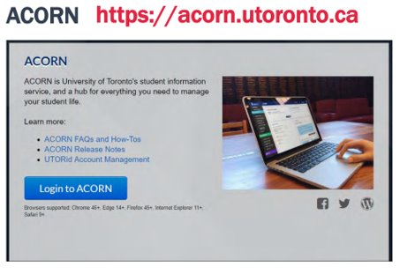
ACORN
Enroll in or drop courses​
View grades​
Invoice for tuition & fees​
Tax slips​
Update contact information​
Order transcripts
Check out the video here (https://youtube/UaUS696-uzs) to learn about ACORN.​
ACORN FAQs and How-Tos: http://help.acorn.utoronto.ca/how-to/

Slide 25
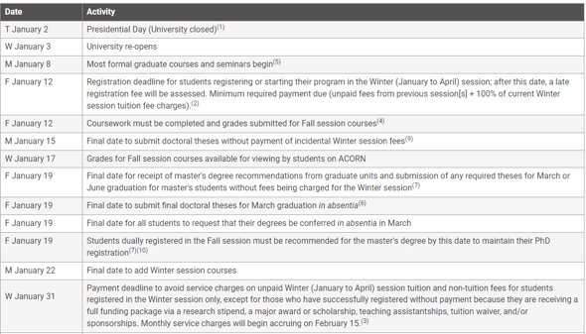
Important Dates
SGS Sessional Dates Calendar: https://sgs.calendar.utoronto.ca/sessional-dates​

Slide 26
Advice on Waitlists & the Drop Deadline
Waitlist
If you are on a waitlist:
Consider letting the course instructor know your interest.
Remain on the waiting list – students could drop the course within the first week or two of class.
Popular courses like MIE1624, MIE1622 & MIE1628 have large waitlists and course instructors cannot request that you get a spot.
January 22: Deadline to enroll / add Winter session courses
Dropping a Course
February 20 – Final date to drop Winter session courses without academic penalty
Seek academic advice before the deadline.

Slide 27
The Association of Mechanical and Industrial Engineering Graduate Students (AMIGAS)
AMIGAS is the graduate student association in the Department of Mechanical and Industrial Engineering.
AMIGAS hosts social, athletic, academic, and professional development events open to all MIE graduate students.
Website: amigas.mie.utoronto.ca
Instagram: @amigas_mie_uoft

Slide 28
AMIGAS: Your MIE Graduate Student Group
Association of Mechanical and Industrial Graduate Students

Slide 29
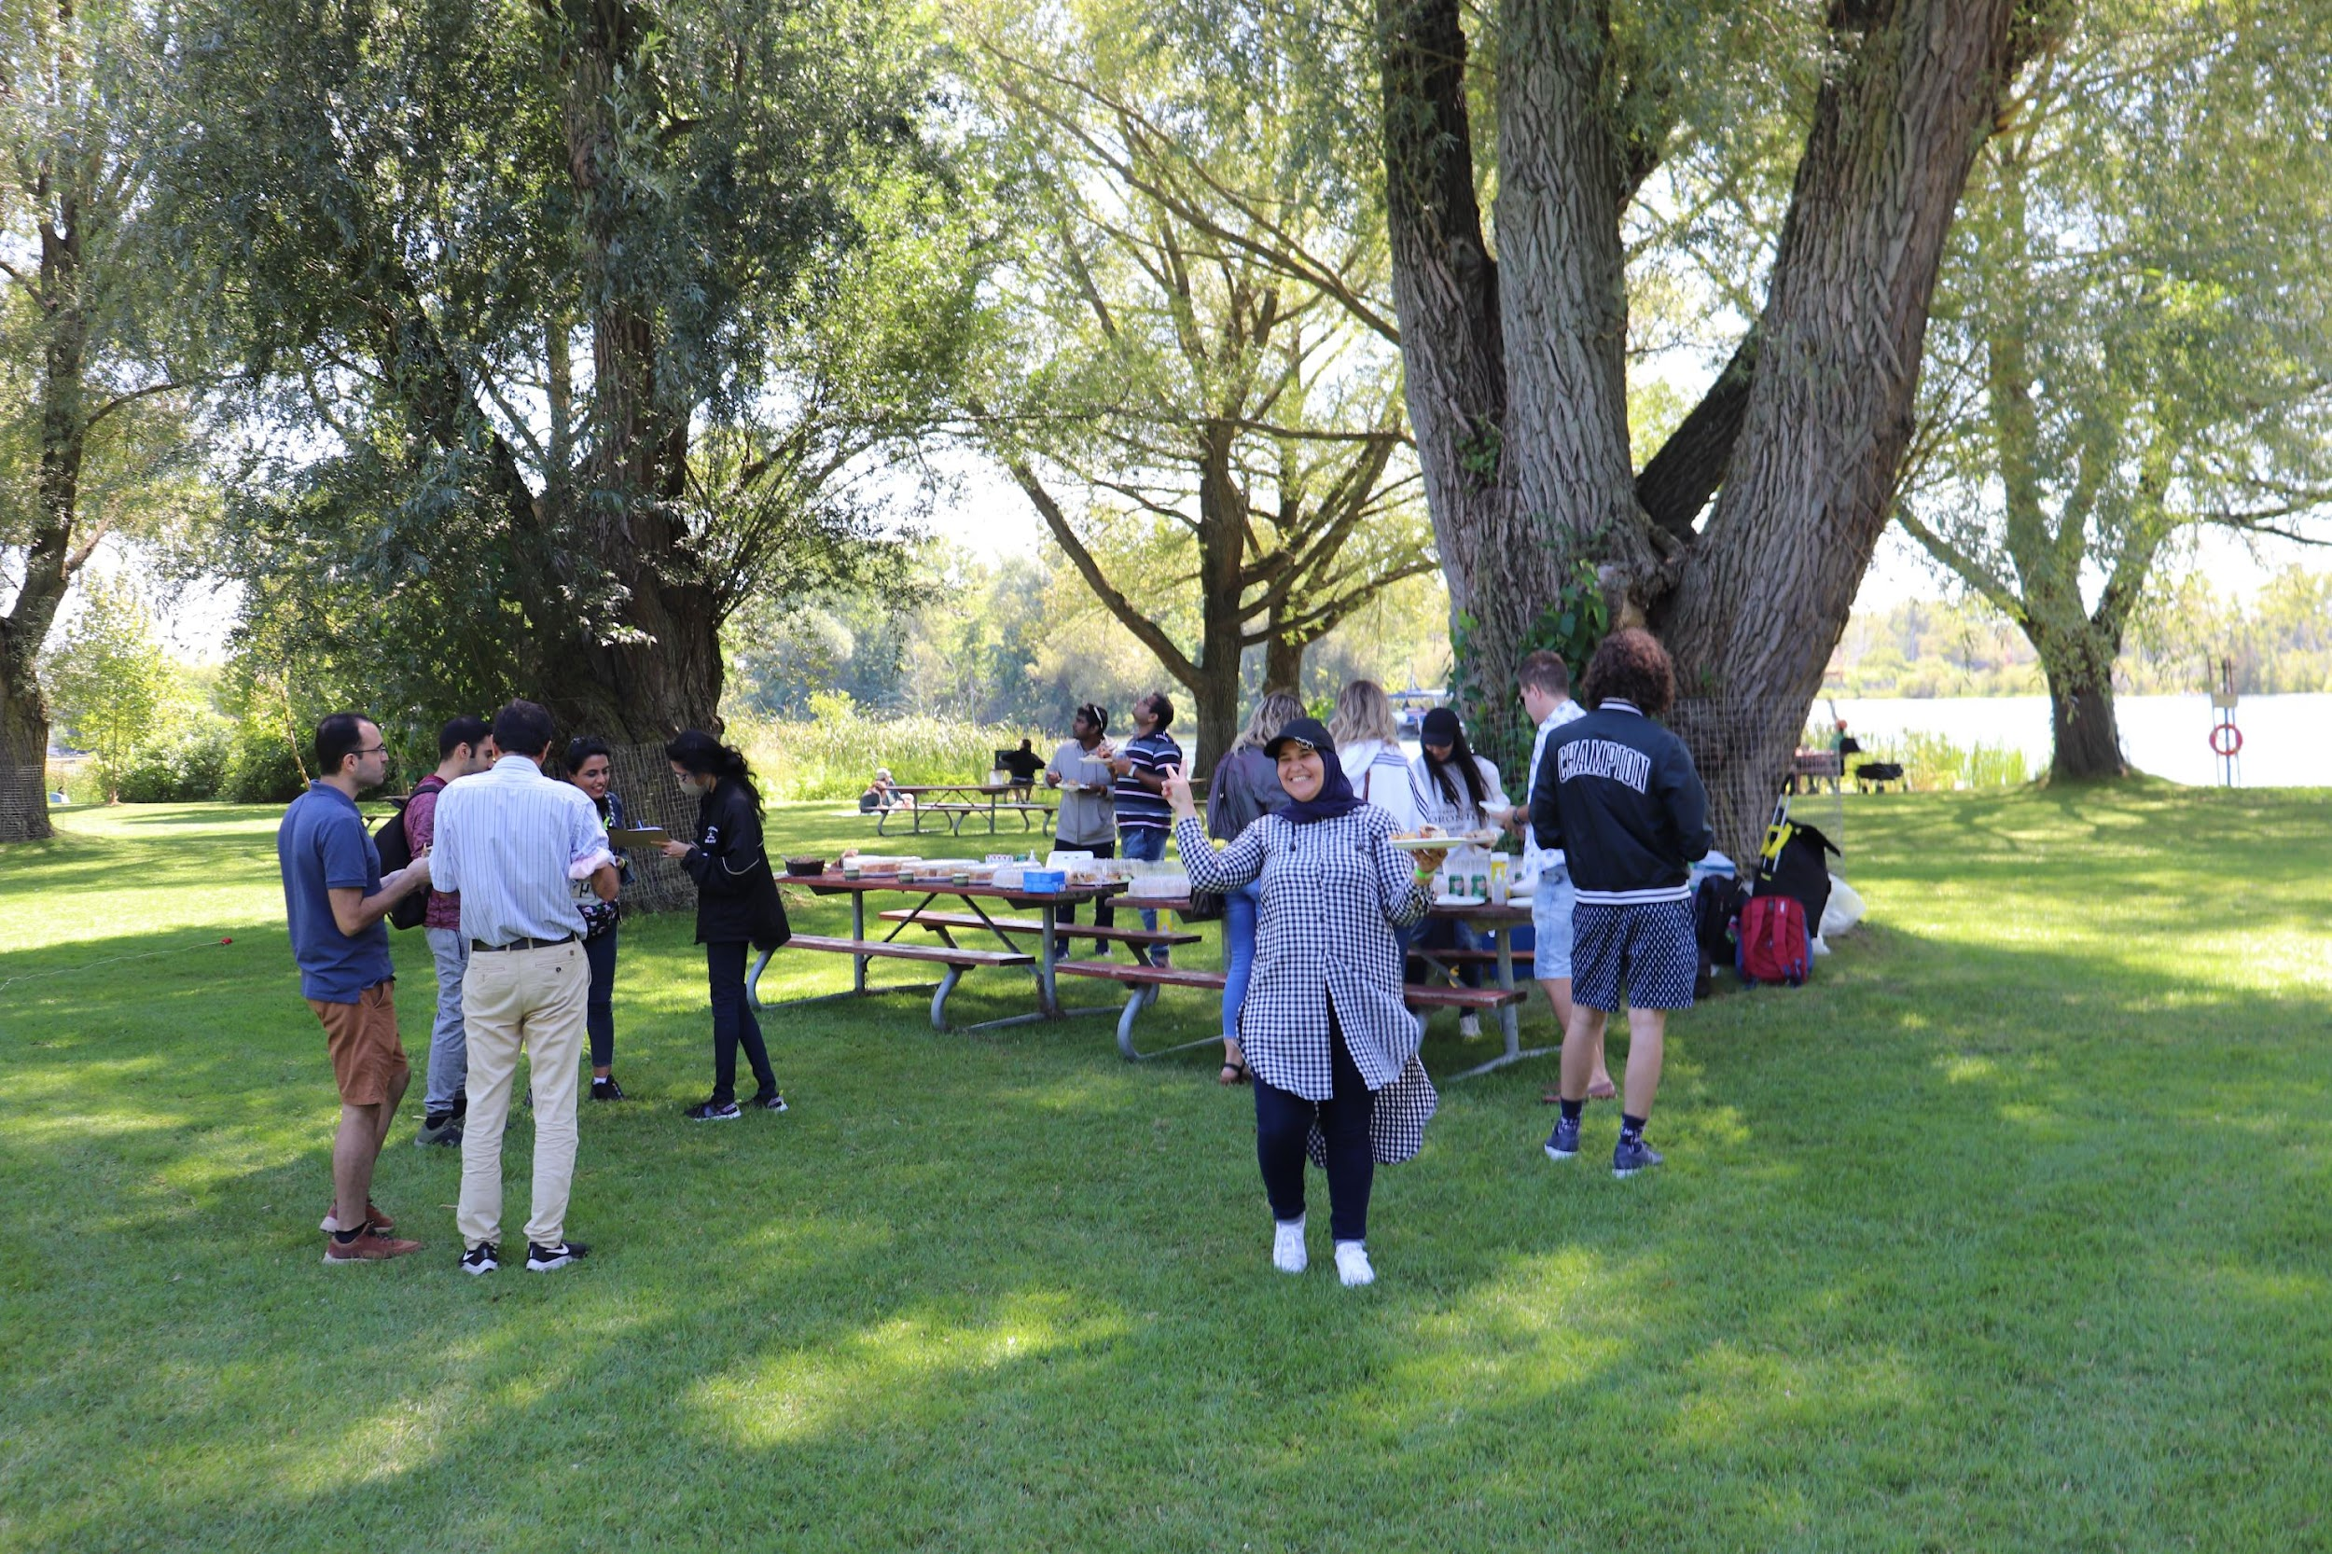
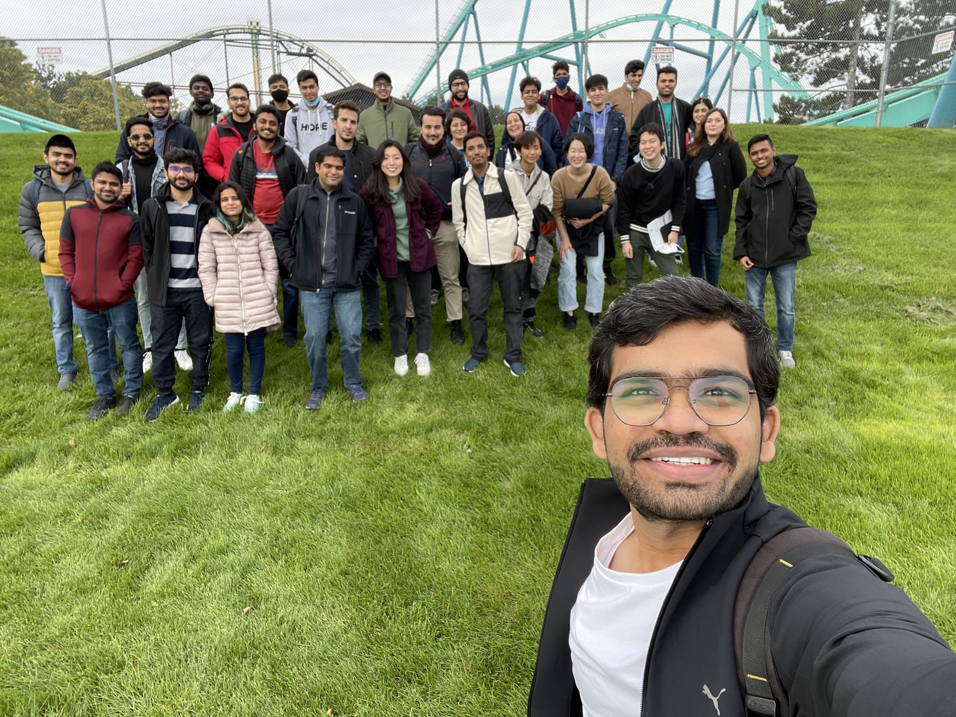
Fall Activities
Picnics, Wonderland, Welcome BBQ Event, Coffee Break Events, Distillery District etc. in Fall.
Welcome Back BBQ
Board Games Event
Toronto Island Picnic
Pizza Party
Wonderland Event

Slide 30
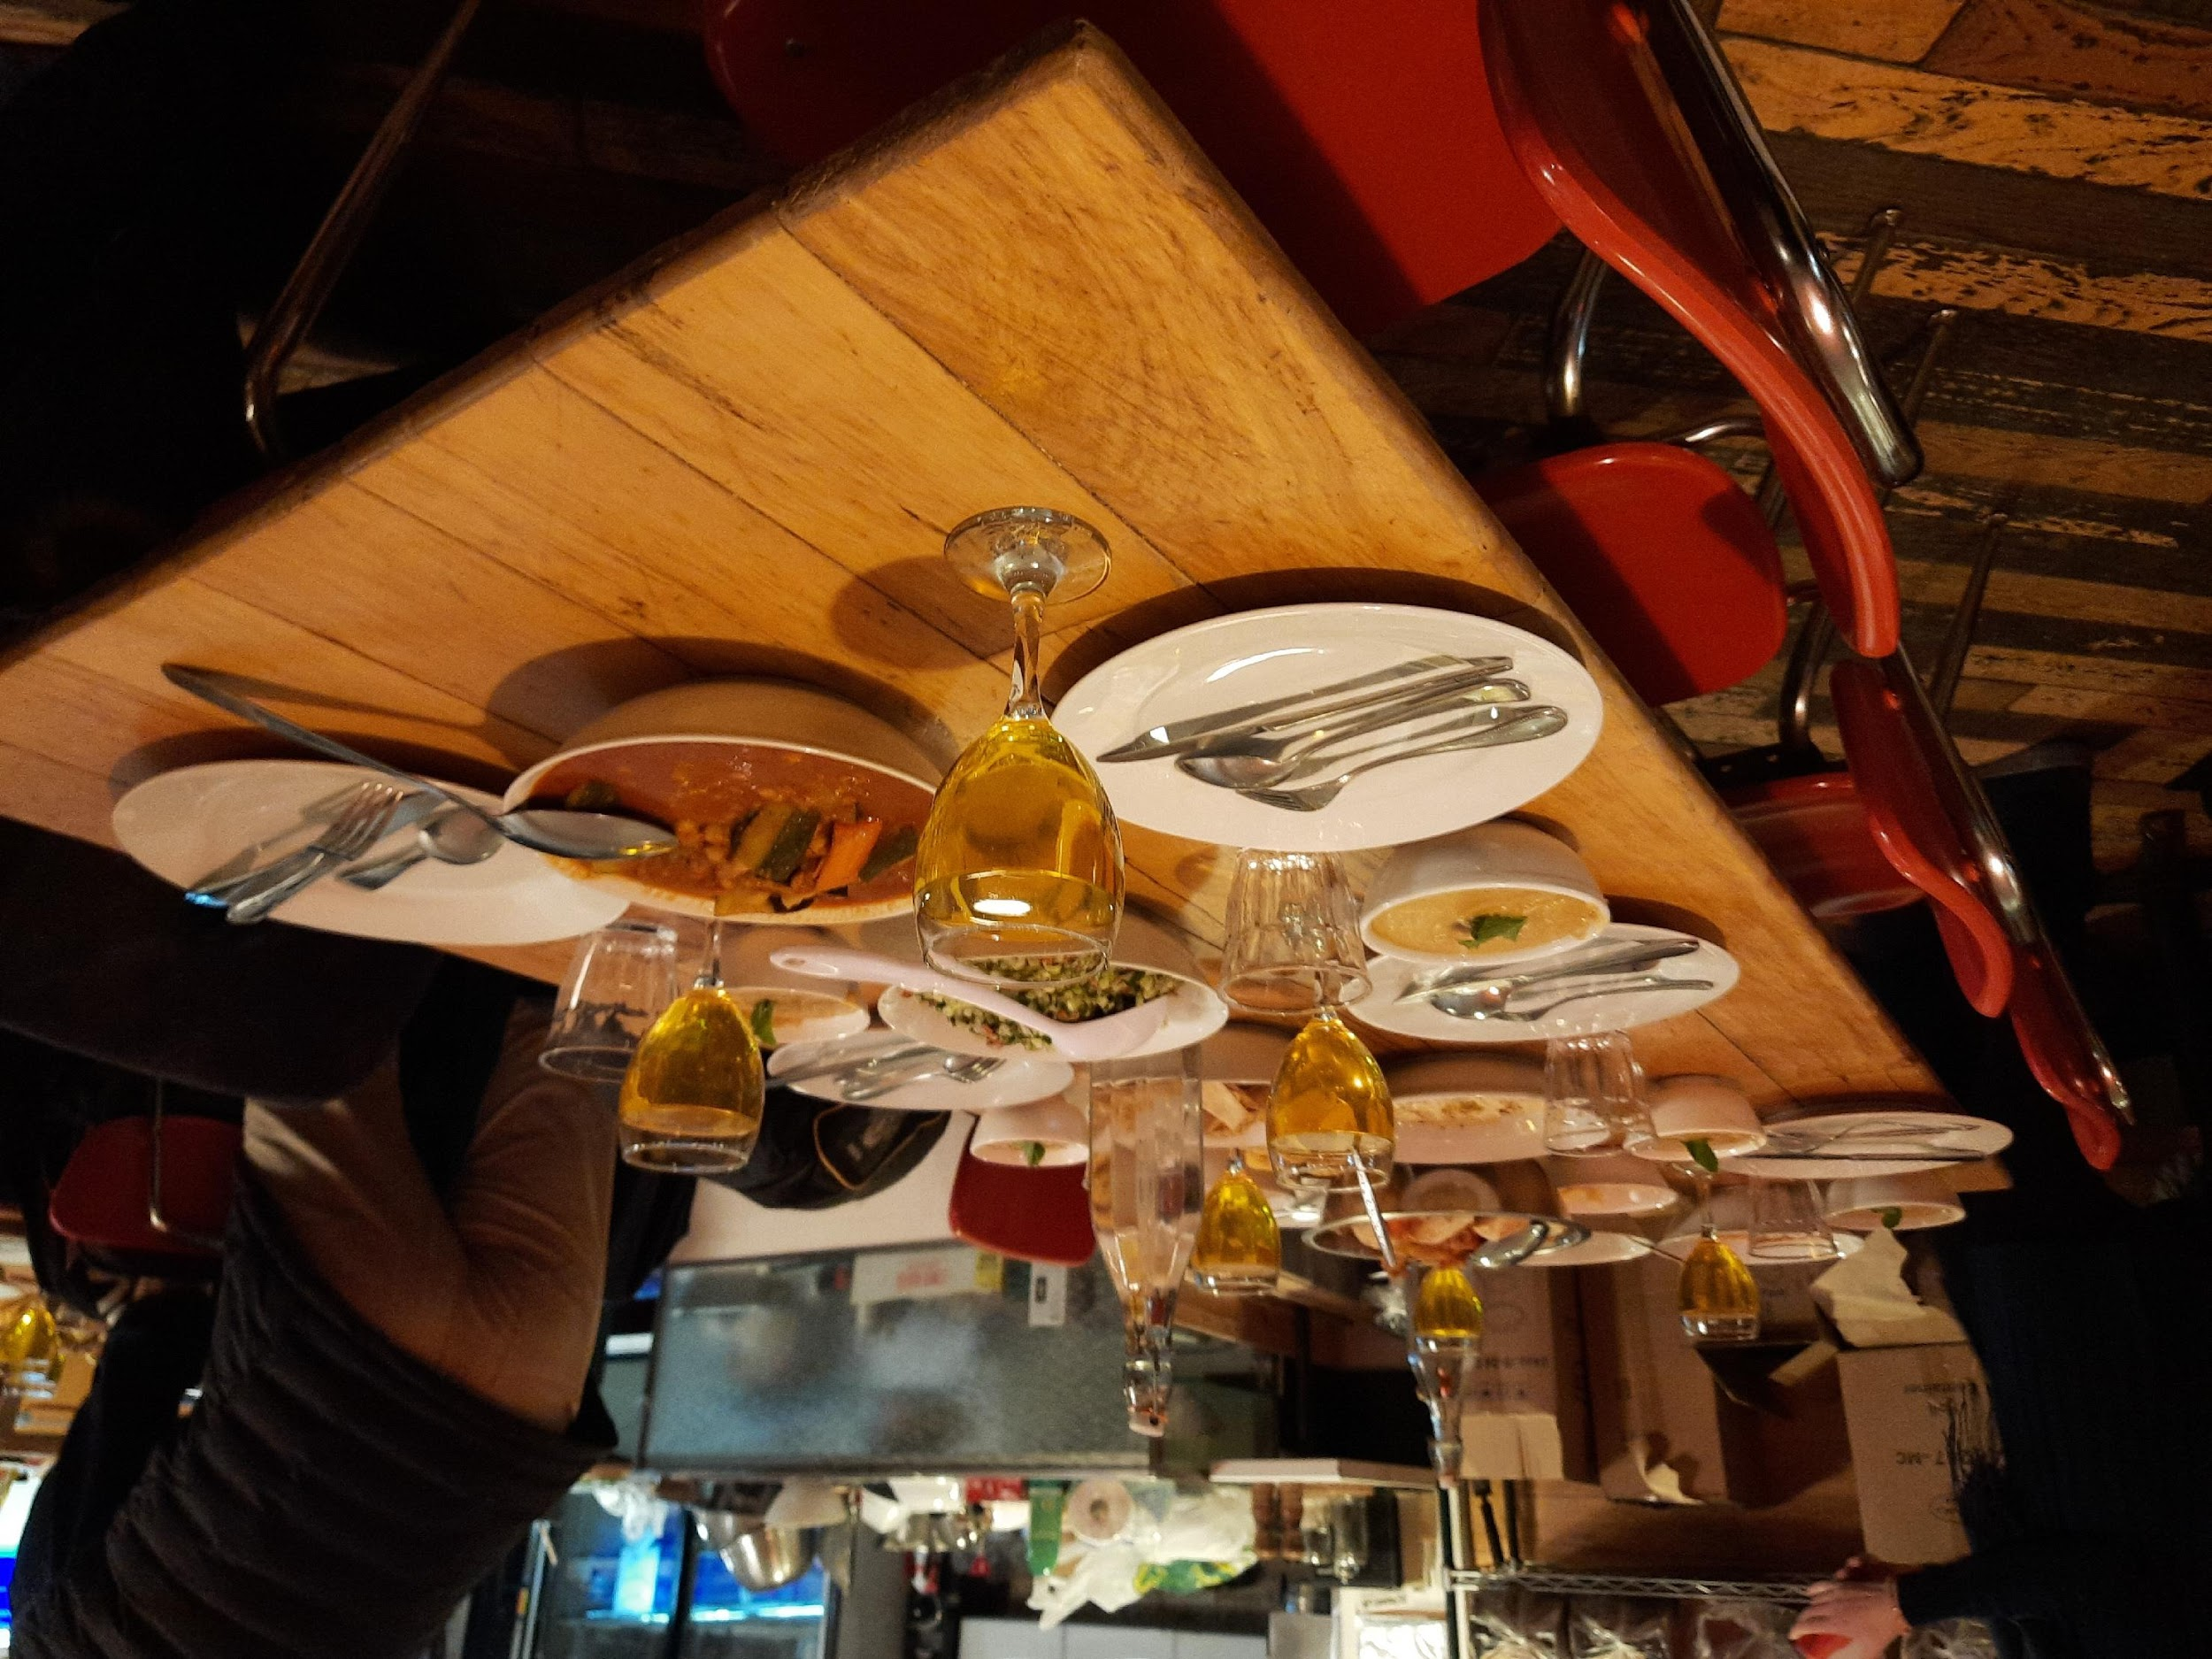
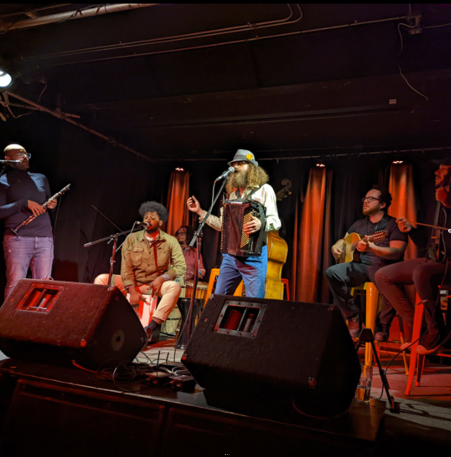
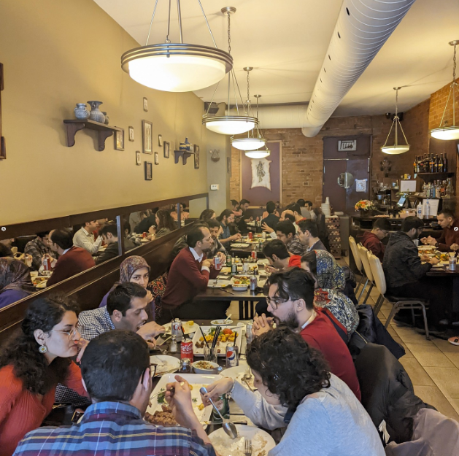
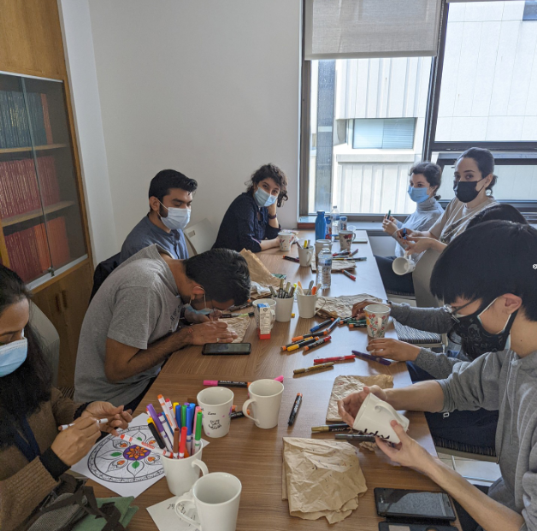
Winter Activities
Intercontinental Cooking Class, Persian New Year, Chinese New Year, Musical Event etc. in Winter.
Intercontinental Cooking
Musical Event
Persian New Year
Painting Event

Slide 31
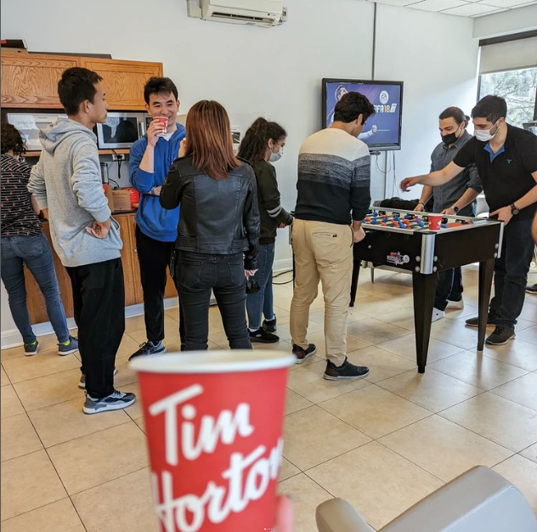
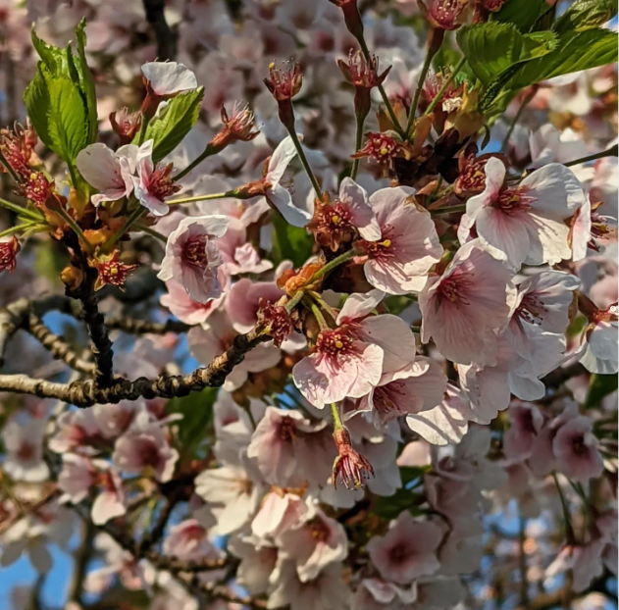
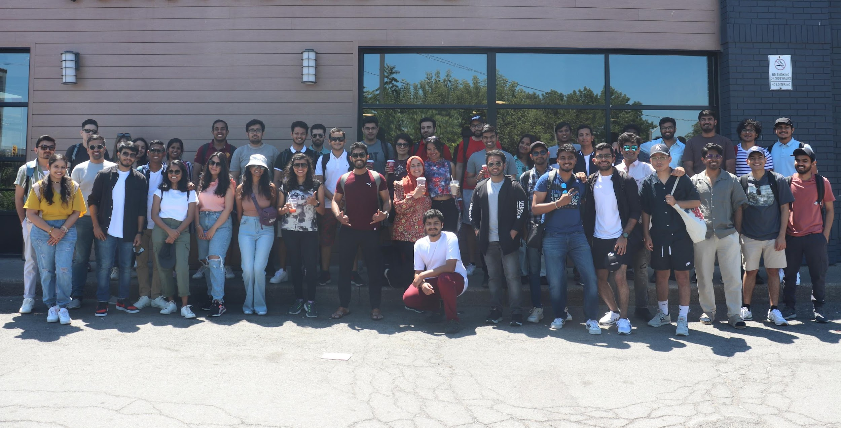
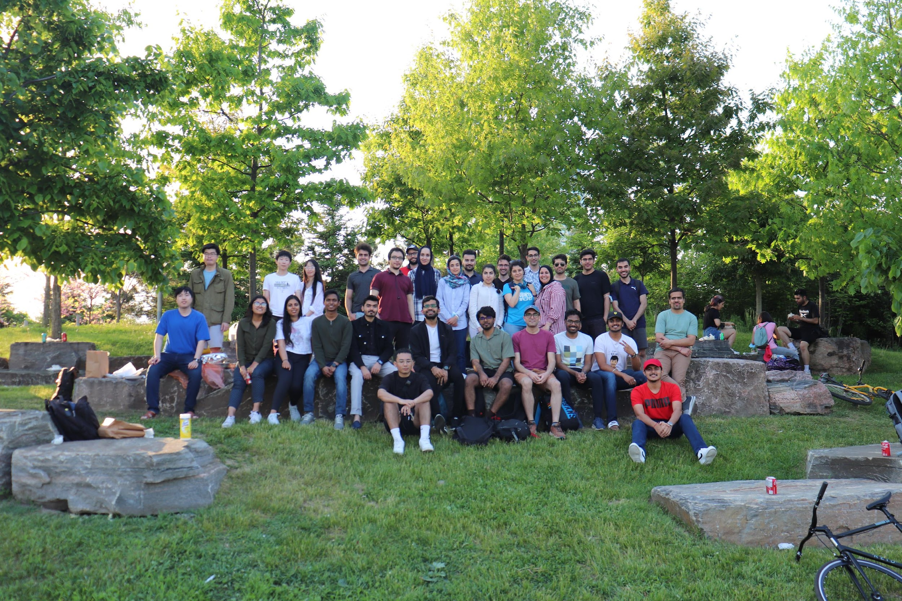
Summer Activities
Cherry Blossoms, Niagara Falls, Canada’s wonderland, Trillium Park Picnic, Trampoline Park Event, etc. in Summer 2022.
Coffee Break Event
Cheery Blossom Event
Niagara Falls Event
Persian New Year
Trampoline Park Event
Trillium Park Picnic Event

Slide 32
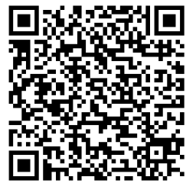
The social events do not end here ..
Welcome Back Event with the Taste of the Pongal (5$/ticket)
Friday, January. 19th starting at 6 pm
Notes:
Keep an eye on the newsletter, family-friendly, free

Slide 33
Academic and Professional Development Activities
Student seminar series and mentorship program
Professional development events: Networking, Alumni Event and Job Search events
Master you job search!
Networking with LinkedIn!

Slide 34
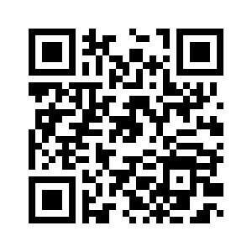
The professional events do not end here ..
Resume & Cover Letter Workshop (Career Exploration and Education)
Friday, January. 26th starting at 12:30 pm-Lunch will be offered
Notes:
Keep an eye on the newsletter, family-friendly, free

Slide 35
Interested in joining AMIGAS as an executive???
We run our summer elections in May. Stay tunned ;)
Conditions for becoming an exec:
Be a full time or part time Gard student at MIE for this academic year (2024-2025).

Slide 36
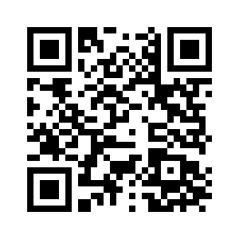
Stay In Touch
The best way to stay in touch is to follow our Instagram Page and our Weekly Newsletters.
Make sure to add our email
amigas@mie.utoronto.ca
to your trusted contact!

Slide 37
Thank you!
Questions?

Slide 38
Our Faculty
Over 60 dedicated faculty members
Experts in their fields
Leaders in ground-breaking research

Slide 39
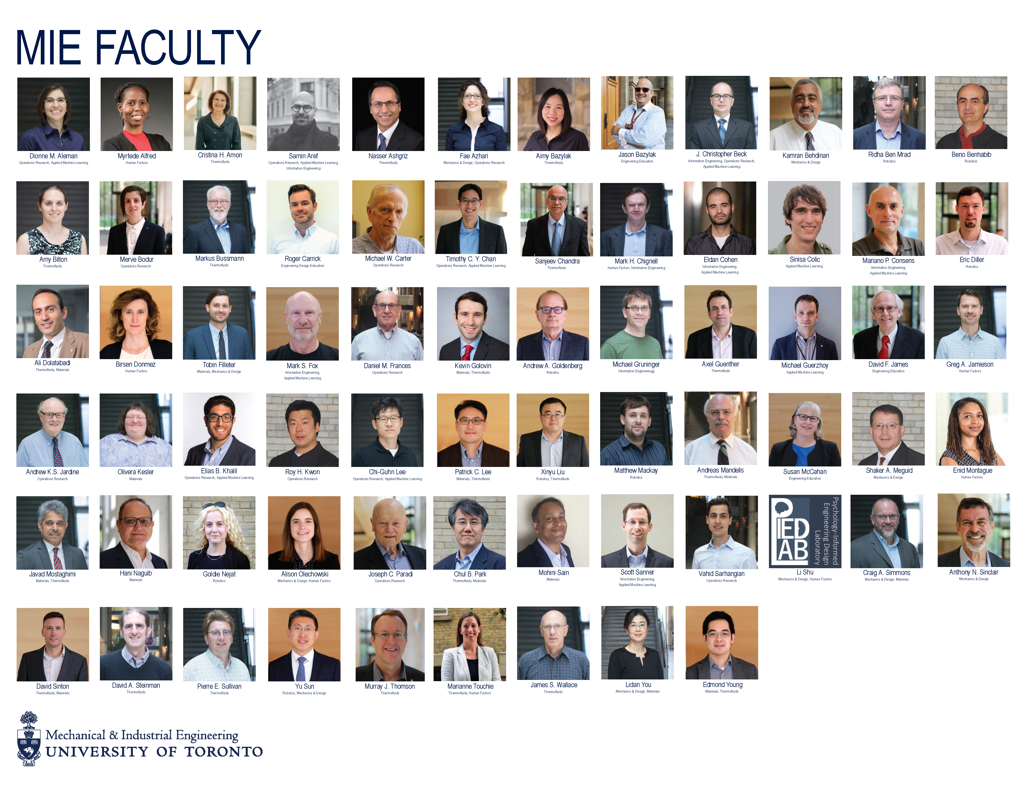

Slide 40
MIE Faculty in the News
Professor Goldie Nejat
Professor Tim Chan
Global News: “Conversations with Alexa: How robots are helping Canada’s aging population connect”
CTV News: “Around the clock: Experts weigh in on speeding up Canada’s vaccination rollout”

Slide 41
Our Alumni
Graduates of our MEng program go into careers such as:
Project Engineer (Bruce Power)
Associate Category Business Manager (Canadian Tire Corporation)
Mechanical Designer (GE Aviation)
Equity sales (scotiabank)
Software Engineer (Sorting Hat Analytics)
Strategic Sourcing and Network Planning (Apple Inc)
Research Fellow (The Hong Kong Polytechnic University)

Slide 42
Ewura-Abena Bourne
MechE MEng (2017)
Si Hsu
IndE MEng (2018)
Junior Mechanical Designer and Robotics Simulator at Systematix Inc
Vice President at Citi

Slide 43
University-wide Supports:
Centre for International Experience (resource centre for International Students, study permits, travelling abroad etc)
Graduate Centre for Academic Communication (GCAC) (training in academic writing and speaking)
UofT Career Learning Network (workshops, networking events, job postings, career fairs etc.)
SGS Resources & Supports (academic workshops, guides for degree success, book meeting rooms)

Slide 44
Engineering Faculty Supports:
Engineering Grad Career Development
ILead and ILead:Grad | Leadership development programming and events
Graduate Peer and Career Support (Grad PACS) | Engineering grad students guides for advice
Hatchery, H2i, OnRamp | Entrepreneurship programs
U of T Engineering CONNECT | Web platform to network with U of T Engineering Alumni
Alumni Mentorship Program

Slide 45
Myhal MEng Lounge
MEng students have a dedicated space (MY660) on the sixth floor of the Myhal Centre for Engineering Innovation and Entrepreneurship.
Myhal MEng Lounge Code: 3456

Slide 46
Quick Tips
Graduate school is what you make it – establish your goals.
Take initiative, be aware of deadlines and ask for clarification when needed.
Leverage the U of T alumni network - join Engineering CONNECT.
Attend networking sessions and make relationships outside the laboratory/classroom.
Prioritize a work-life balance.
Stay physically and mentally well. Seek out support if you need it.

Slide 47
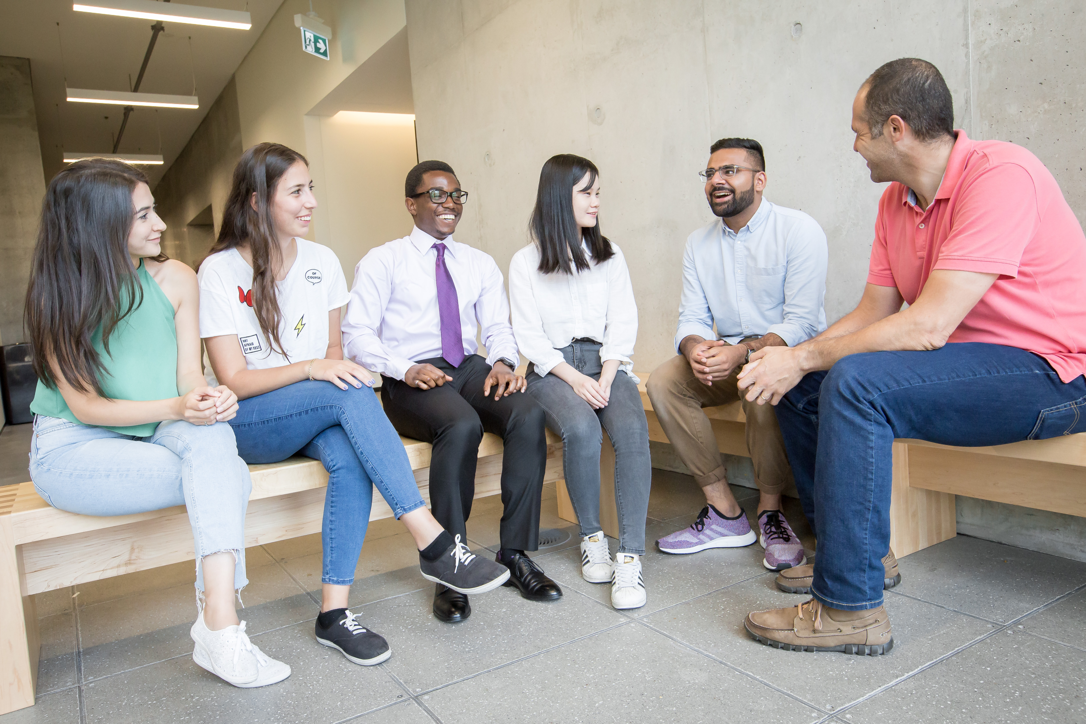
Graduate Programming
Notes:
Hello and welcome to U of T Engineering. My name is Joanne Lieu I work with the Vice Dean, Graduate Studies to support the professional development of graduate students and postdoctoral fellows.
I offer a number of programs to help you
Get involved in school beyond your courses and research
Meet new friends and build community
Develop skills that will support you at school and beyond

Slide 48
Questions?

