Slide 1
MASc & PhD Orientation
Winter 2024
January 10, 2024

Slide 2
Land Acknowledgement
We wish to acknowledge this land on which the University of Toronto operates. For thousands of years it has been the traditional land of the Huron-Wendat, the Seneca, and the Mississaugas of the Credit. Today, this meeting place is still the home to many Indigenous people from across Turtle Island and we are grateful to have the opportunity to work on this land.

Slide 3
Welcome & Department Overview
People
Programs
Levels of University Support

Slide 4
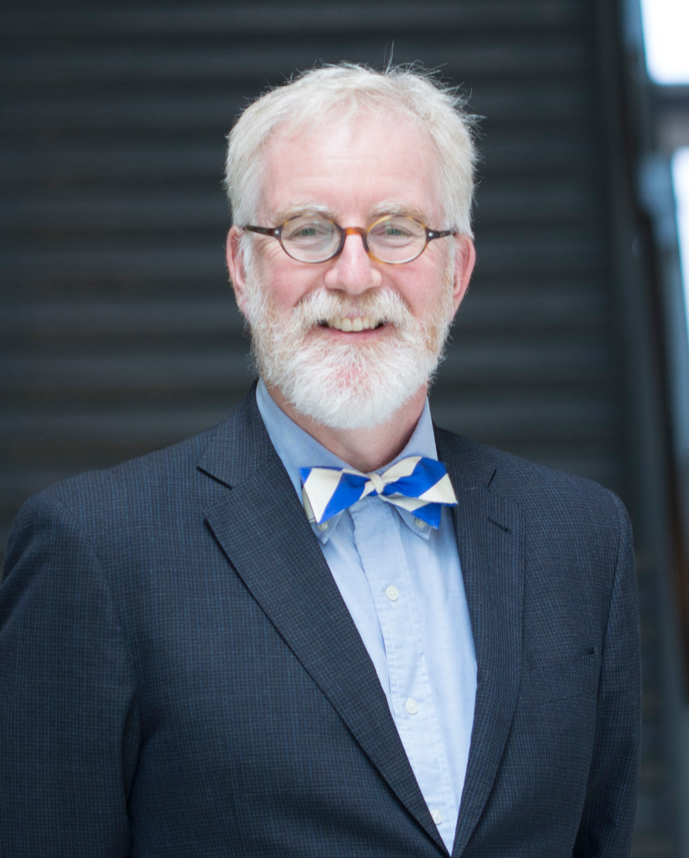
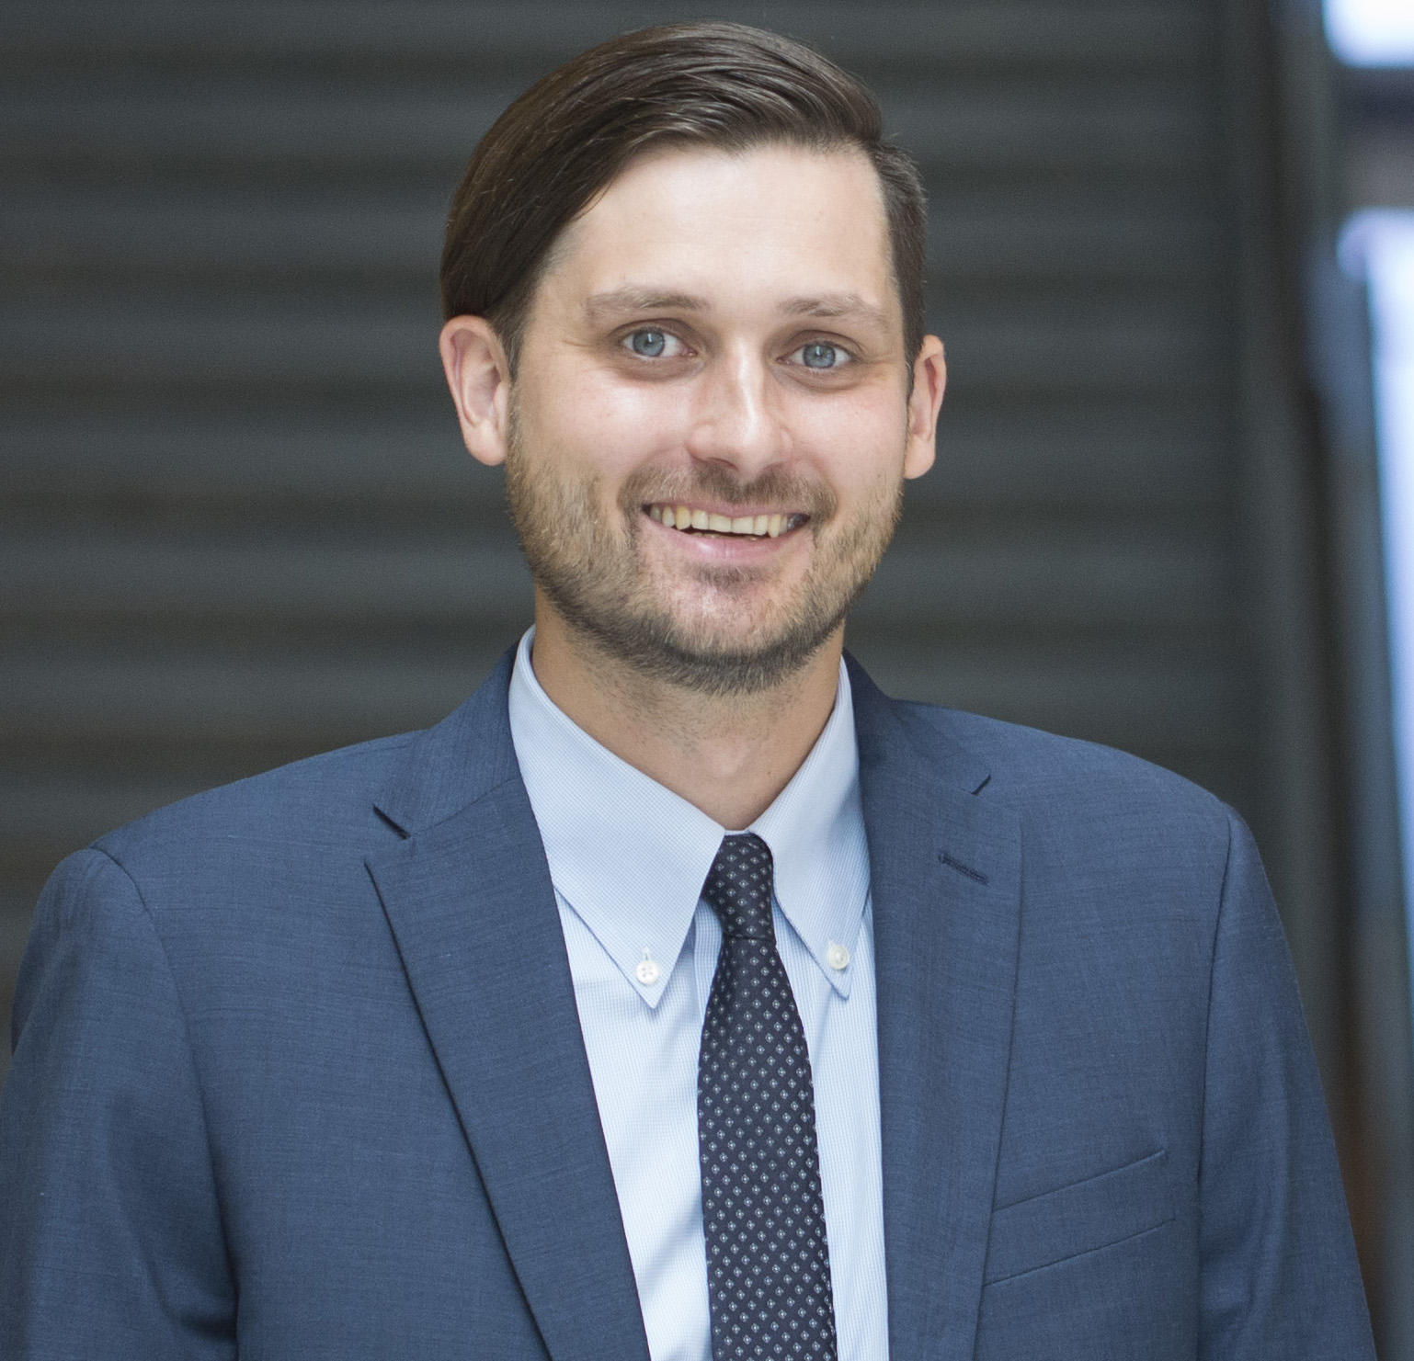
Professor Markus Bussmann
Professor Tobin Filleter
Department Chair
Associate Chair of Graduate Studies

Slide 5
Graduate Office Staff – MASc/PhD Support | MC 108
Carla Baptista, Manager of Academic Programs
Oversees the Graduate and Undergraduate Academic Programs
Supports MEng Student Advising
Sandra Borges, MASc/PhD Graduate Program Advisor
Admissions
PhD/MASc student support
Funding related questions
Academic advising
Processes graduation requirements for all Graduate Programs
Leila Alijeva, Graduate Program Assistant
Graduate student support

Slide 6
Graduate Office Services
Academic Advice
Course enrollment & course selection support
Graduation & degree checks
Funding information
Program Requirements & timeline

Slide 7
Levels of University Support
Engineering departments supports their graduate students with specifics in their academic program.
Faculty of Applied Science and Engineering, Graduate Studies (FASE) supports students with professional development programs and events, oversees Faculty-Wide engineering courses.
School of Graduate Studies (SGS) supports all graduate students with a variety of services and resources (policies, awards, financial aid, career development, academic writing/speaking and more).

Slide 8
School of Graduate Studies (SGS) Office
The SGS supports graduate students across the University. Please refer to the SGS website for:
University-wide policies and guidelines:
  SGS Code of Behaviour on Academic Matters, plagiarism, offenses, appeals
  Code of Student Conduct, harassment, violence
  No working full time for research students
Important dates and deadlines (i.e. sessional dates)

Slide 9
MASc: Requirements & Timelines

Slide 10
Requirements & Restrictions
Complete 4 graduate level courses:
  2 must be from MIE
  Up to one Reading course
  Up to one APS course
Complete JDE1000H (Ethics in Research Seminar) in the 1st or the 2nd term of registration.
Attend a minimum of 70% of departmental seminars (MIE Distinguished MIE Seminar Series) in the first 2 years.
Notes:
MASc Step-by-Step. Add screenshot of checklist.

Slide 11
MASc Program Timeline
Year 1
Complete a minimum of 4 graduate courses (at least 2 from MIE)
Attend JDE1000 Ethics Course
Attend 70% of SRM MIE Seminar Series
Year 2
Continue to work on Thesis
Hold MASc Oral Exam by end of 2nd year
Exam committee consists of your supervisor + 1 member
Notes:
Change to Congratulations. Next steps – clear conditions, TCard etc.

Slide 12
PhD: Requirements & Timelines

Slide 13
Requirements
Complete 5 graduate level courses (or more depending on PhD program):
  3 must be from MIE
  Only one Reading course
  Only one APS course
  Only one 500-level course
Complete JDE1000H (Ethics in Research Seminar) in the 1st year of study.
Attend a minimum of 70% of departmental seminars (MIE Distinguished MIE Seminar Series) in the first 2 years.

Slide 14
Qualifying Exam
Purpose
To assess the prospects that:
the student will complete a quality PhD thesis, and
will develop the ability to operate as an independent researcher
Assessment is made by:
student’s supervisor
minimum two other SGS Faculty members (MIE majority)
Timeline
  12 months - PhD students with a Master’s
  8 months - Fast Track PhD students - after fast-tracking from a Master's degree
  16 months - Direct entry from a Bachelor’s
  24 months - Flex-time PhD students

Slide 15
PhD Program Timeline
Year 1
Complete a minimum of 4 graduate courses (at least 3 from MIE)
Attend JDE1000 Ethics Course
Attend 70% of SRD MIE Seminar Series
Hold Qualifying Exam within 12 months from PhD registration
Year 2
Complete 5th graduate level course
Attend 70% of SRD MIE Seminar Series
Hold 1st PhD Committee Meeting within 24 months from registration
Year 3
Continue work on thesis
Hold 2nd PhD Committee Meeting within 36 months from registration
Year 4
Continue work on thesis
Hold 3rd PhD Committee Meeting within 48 months of registration or
Hold MIE Dept Exam after thesis submission to committee or
Hold Final Oral (FOE) by end of 4th year of program
Notes:
Change to PhD Program Path. Add image, add checklist etc. Highlight the PhD programs in flex-time/direct entry etc. One slide per program.

Slide 16
Good Academic Standing
What Constitutes Good Academic Standing?
Attend Orientation Session​
No FZ ​
Average grade A- or above.​
Qualifying Exam within 12 months of registration ​
    At least four courses to be completed ​
    JDE/Ethics​
    MIE Seminar credits​
Annual PhD Progress Meetings​
*Failure to maintain good academic standing may result in various sanctions, including ineligibility for financial assistance, lowest priority for bursaries and assistantships, and even termination.

Slide 17
Graduate Courses

Slide 18
Courses
All MIE graduate courses are open to our students (MEng, MASc and PhD)
500 or 1000 level courses, or higher (500 level joint with undergraduate students)
Reading Courses (MIE2002H, MIE2003H – Mechanical); (MIE2004H, MIE2005H – Industrial)*
*under the direction of your supervisor and assigned a CR/NCR final grade
Course enrollment is done via ACORN or by completing the Add Course Form
Course selection should be discussed with your supervisor
MIE Graduate Courses and Course Schedule can be found on our website here : 2023/2024 Graduate Course Schedule.
Notes:
Change to PhD Program Path. Add image, add checklist etc. Highlight the PhD programs in flex-time/direct entry etc. One slide per program.

Slide 19
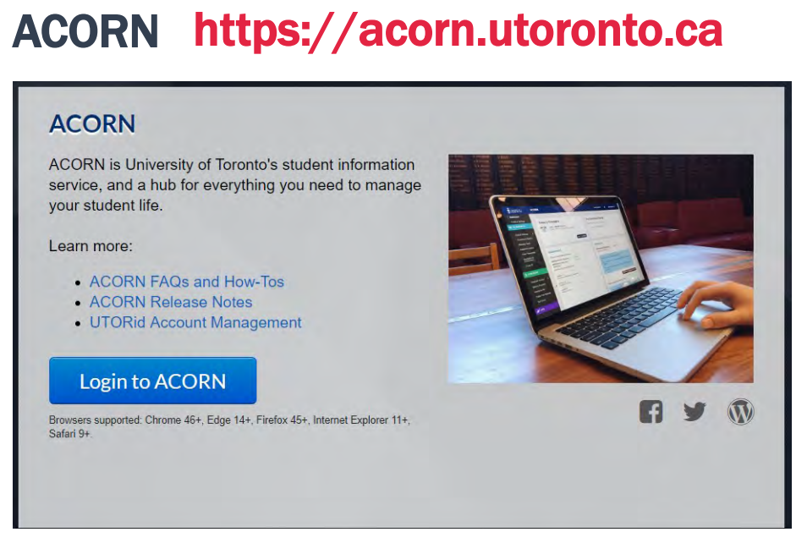
Tools – ACORN & GMS
Enroll in or drop courses
View grades
Check student account
Invoice for tuition & fees
Payment deferral
Direct deposit
Tax slips
Update contact information
Graduation information
Order transcripts

Slide 20
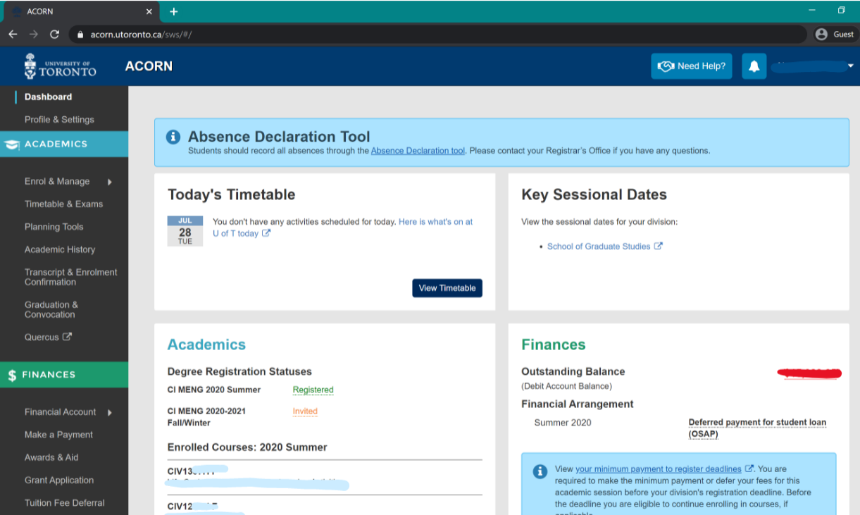
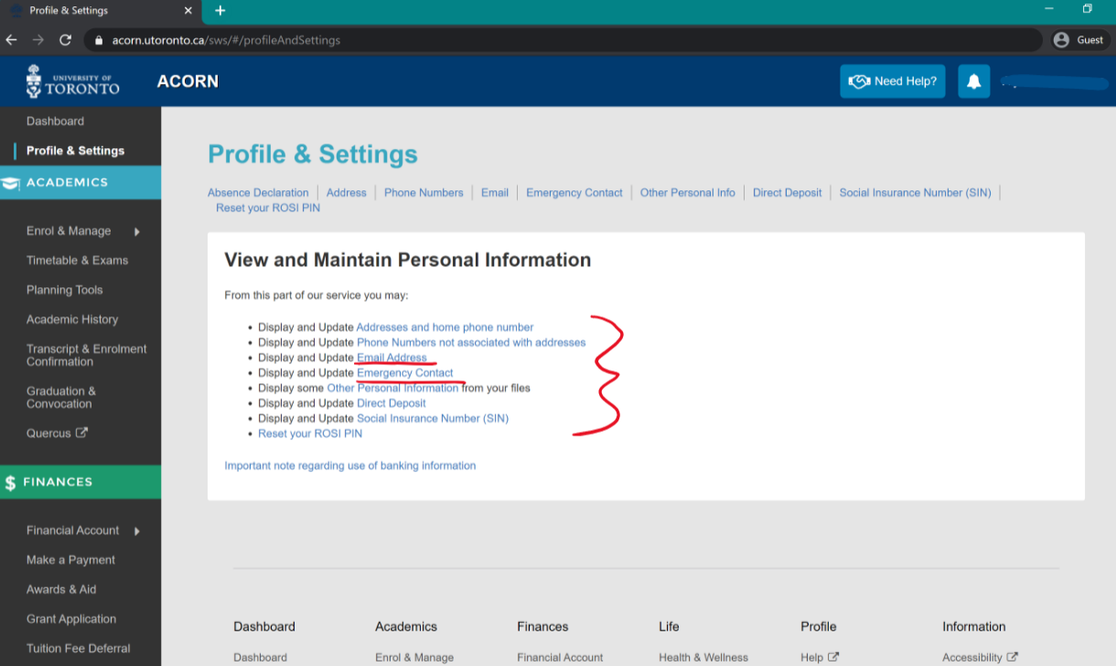
Tools – ACORN & GMS continued…
Check out the video here (https://youtube/UaUS696-uzs) to learn about ACORN.
ACORN FAQs and How-Tos: http://help.acorn.utoronto.ca/how-to/

Slide 21
Tools – ACORN & GMS continued…
MIE Graduate Student Management System (GMS) https://grad.mie.utoronto.ca/
GMS is the hub for MIE graduate students to monitor their program progress
Mandatory for arranging Qualifying and Committee meetings and MASc final oral exams
Program funding letter available on GMS
  Review with supervisor and acknowledge online
  If there are any concerns regarding funding letter, email gradoffice@mie.utoronto.ca

Slide 22
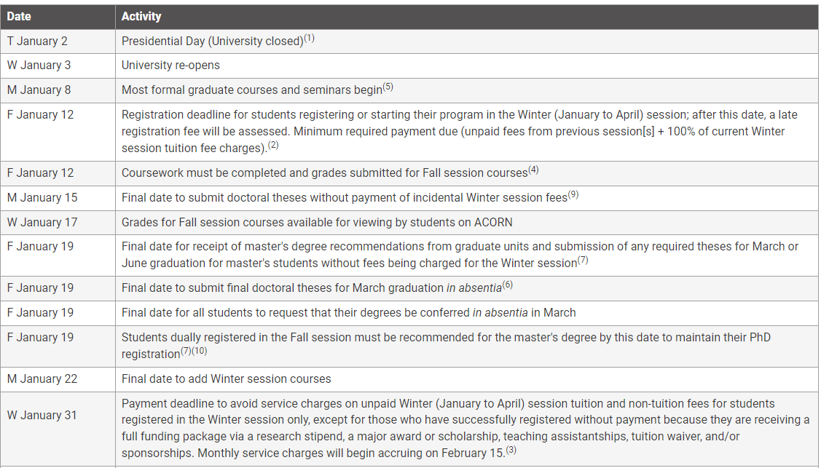
Important Dates
SGS Sessional Dates Calendar: https://sgs.calendar.utoronto.ca/sessional-dates

Slide 23
Health and Safety
All students are required to complete the department safety training when joining MIE and once a year as a refresher. The link below provides a training manual, a short test, and a confirmation when completed.
https://www.mie.utoronto.ca/safetytest
Students using research labs that have chemicals or other hazards must complete training related to those hazards. The link below provides a matrix of available training.
https://ehs.utoronto.ca/training/laboratory-personnel/
Lab supervisors may also provide additional training specific to equipment or processes used in their labs.
Students should review the safety training requirements with their supervisors.

Slide 24
Our Faculty
Over 60 dedicated faculty members
Experts in their fields
Leaders in ground-breaking research

Slide 25
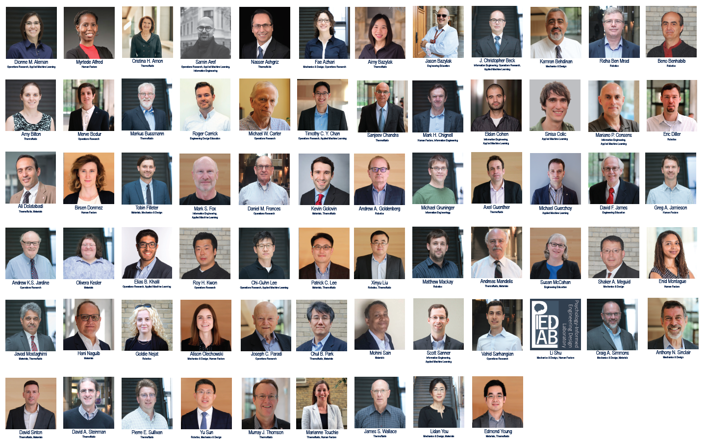

Slide 26
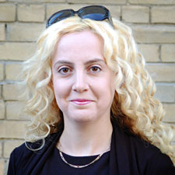
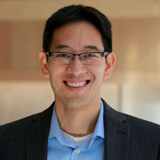
MIE Faculty in the News
Professor Goldie Nejat
Professor Tim Chan
Global News: “Conversations with Alexa: How robots are helping Canada’s aging population connect”
CTV News: “Around the clock: Experts weigh in on speeding up Canada’s vaccination rollout”

Slide 27
How to Succeed & Resources
Quick Tips
Communicating with your Supervisor
Common Expectations
Graduate Student Supports (Faculty & University-wide)
MIE Graduate Student Management System (GMS)

Slide 28
Our Alumni
Graduates of our MASc program go into careers such as:
Business and Marketing Lead (LEGO)
Member of Faculty (Harvard University)
Medical Produce Development Manager (MDA)
Software Development Engineer (Yahoo! Inc)
Graduates of our PhD program go into careers such as:
R&D Engineer (Genpak)
Director – Rail Solutions (Optym)
Product Design (Interaptix Augmented Reality)
Defence Scientist (Department of National Defence, Canda)

Slide 29
Quick Tips
Graduate school is what you make it – establish your goals.
Take initiative, be aware of deadlines and ask for clarification when needed.
Leverage the U of T alumni network - join Engineering CONNECT.
Attend networking sessions and make relationships outside the laboratory/classroom.
Prioritize a work-life balance.
Stay physically and mentally well. Seek out support if you need it.

Slide 30
Communicating with your Supervisor
Confirm how and how often you will be in contact.
Find out how non-scheduled communication should be handled.
Confirm where and when most of the work will be completed.
Discuss timing of major milestones: courses, paper submission, thesis topic and drafts, turnaround time on written materials etc.
The expected “turnaround time” on drafts of written materials.
Discuss lab etiquette.
Talk about expectations concerning publications & conference presentations.

Slide 31
Common Expectations
As a full-time student, you are required to spend a significant number of hours on academic works such as courses and research.
Since your supervisor is providing Research Assistantship, you are recommended to consult with your supervisor before accepting TA positions.
If you will have to be away, you will have to consult with your supervisor prior to your away to avoid any disruption to the research project you are engaged. This is especially important when you travel internationally.
Failure to maintain good academic standing may result in various sanctions, including ineligibility for financial assistance, lowest priority for bursaries and assistantships, and even termination

Slide 32
Graduate Office Resources & Referrals
Health & Wellness
Learning Strategists
Math Aid & Writing Centre
International Transition Advisor

Slide 33
Engineering Faculty Supports:
Engineering Grad Career Development
ILead and ILead:Grad | Leadership development programming and events
Graduate Peer and Career Support (Grad PACS) | Engineering grad students guides for advice
Hatchery, H2i, OnRamp | Entrepreneurship programs
U of T Engineering CONNECT | Web platform to network with U of T Engineering Alumni
Alumni Mentorship Program

Slide 34
University-wide Supports:
Centre for International Experience (resource centre for International Students, study permits, travelling abroad etc)
Graduate Centre for Academic Communication (GCAC) (training in academic writing and speaking)
UofT Career Learning Network (workshops, networking events, job postings, career fairs etc.)
SGS Resources & Supports (academic workshops, guides for degree success, book meeting rooms)

Slide 35
Funding & Scholarships
Funding Components
How to Access Funding
Accessing Pay Slips and Tax Documents
Business Office Contacts

Slide 36
2023-2024
Funding & Scholarships
Mechanical and Industrial Engineering
University of Toronto
Welcome!!!

Slide 37
Funding and Scholarships
What are the funding components:
MIE Open Fellowship (paid via acorn on October and February)
RA - Research Assistantship (paid via HRIS system in the business office, on a monthly basis)
Scholarship – when applicable to the student
When changes on funding may occur?

Slide 38
Funding Package
How much is it?
https://www.mie.utoronto.ca/programs/graduate/scholarships-funding/

Slide 39
Funding from the Supervisor
RA = Research Assistantship
Documentation required for processing payment on a monthly basis
When payment is made
Where you can see the credit made (bank account update)
TA = Teaching Assistant
Not part of the funding package, payment is made via the business office.

Slide 40
Receiving your funding
How to access your funding:
Fellowship = Student must update information on the acorn system, including bank account
Research Assistantship – Student must provide documentation/information to the business office team

Slide 41
Funding Letter
How to obtain it?
https://gms.mie.utoronto.ca
When the letter will be ready?

Slide 42
T4 and T4A
How to obtain a pay slip:
  Go to the ESS website at https://hrandequity.utoronto.ca/resources/ess.htm with your Utorid and password plus your Personal Number and you can obtain your pay slip on a monthly basis.
Personal Number: Update on GMS
You also can obtain your T4 and T4A on a yearly basis, via this ESS site.

Slide 43
Research Supplies
Research Supplies
a) MC 106 Receive and Delivery
b) Purchases via MIE and how to do it?
c) Approval process and fund
c) Reimbursement of supplies – what is needed

Slide 44
Field Trip and or Conferences
Travel and or conference
a) What is needed:
b) authorization from the PI/supervisor
c) support documentation
d) Expense Claim form and Policy can be found at https://www.mie.utoronto.ca/faculty-staff/forms-support/business-forms/

Slide 45
For any Questions???
Please contact:
Business Office = Travel and Expense Claim at businessoffice@mie.utoronto.ca or room MC134
Purchase Coordinator at purchasing@mie.utoronto.ca
THANK YOU!

Slide 46
Welcome!

Slide 47

AMIGAS: Your MIE Graduate Student Group
Association of Mechanical and Industrial Graduate Students

Slide 48
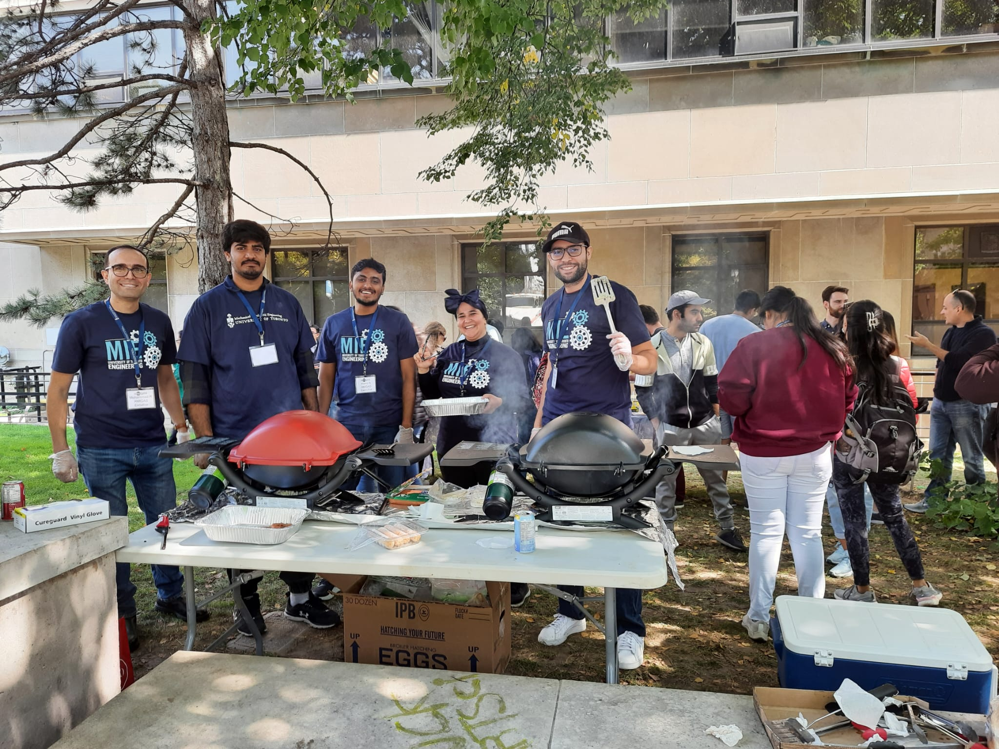

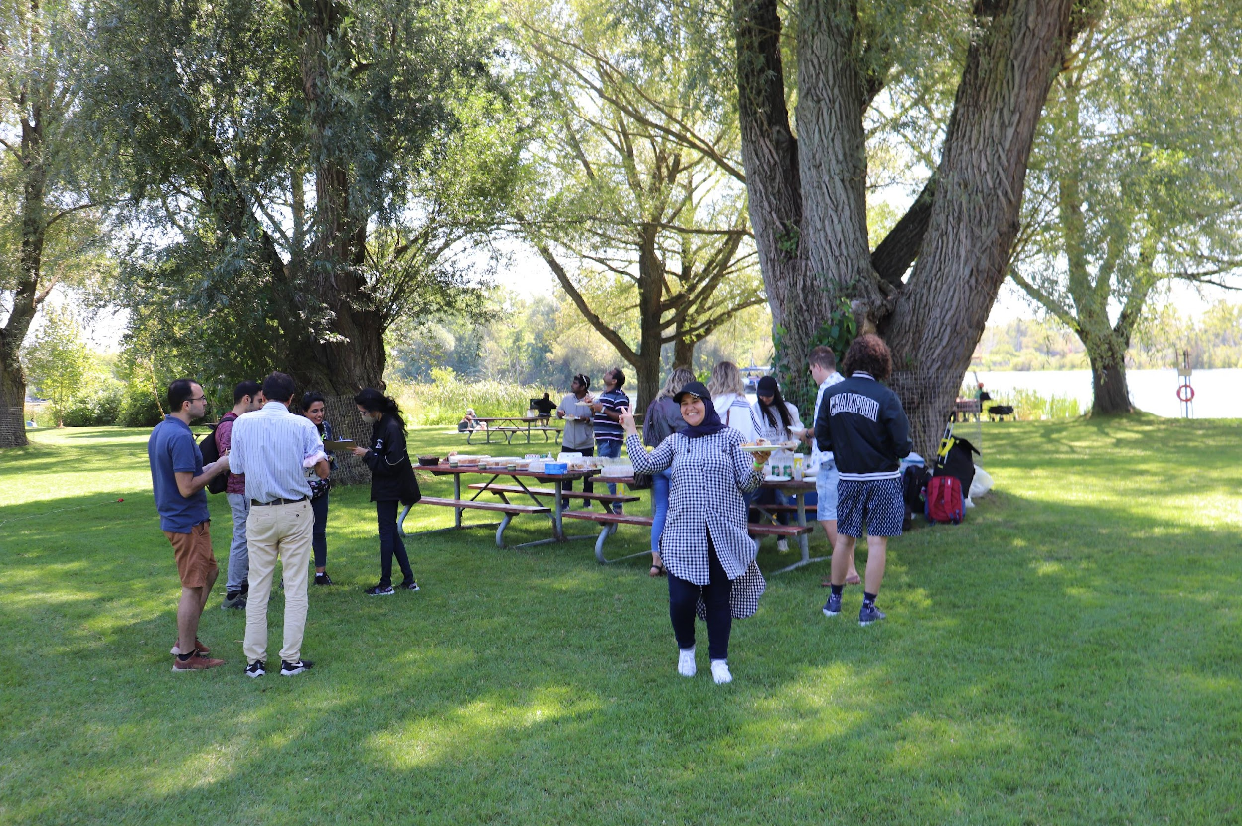
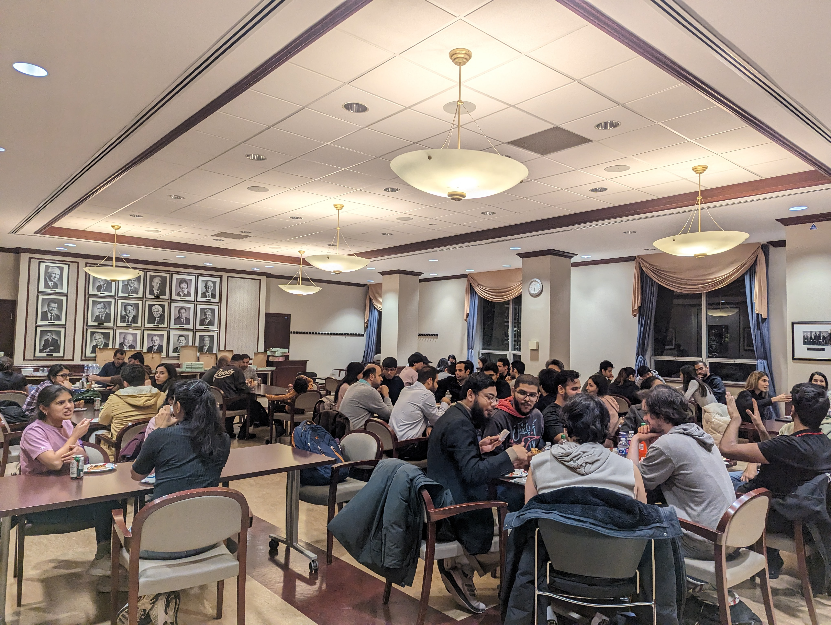
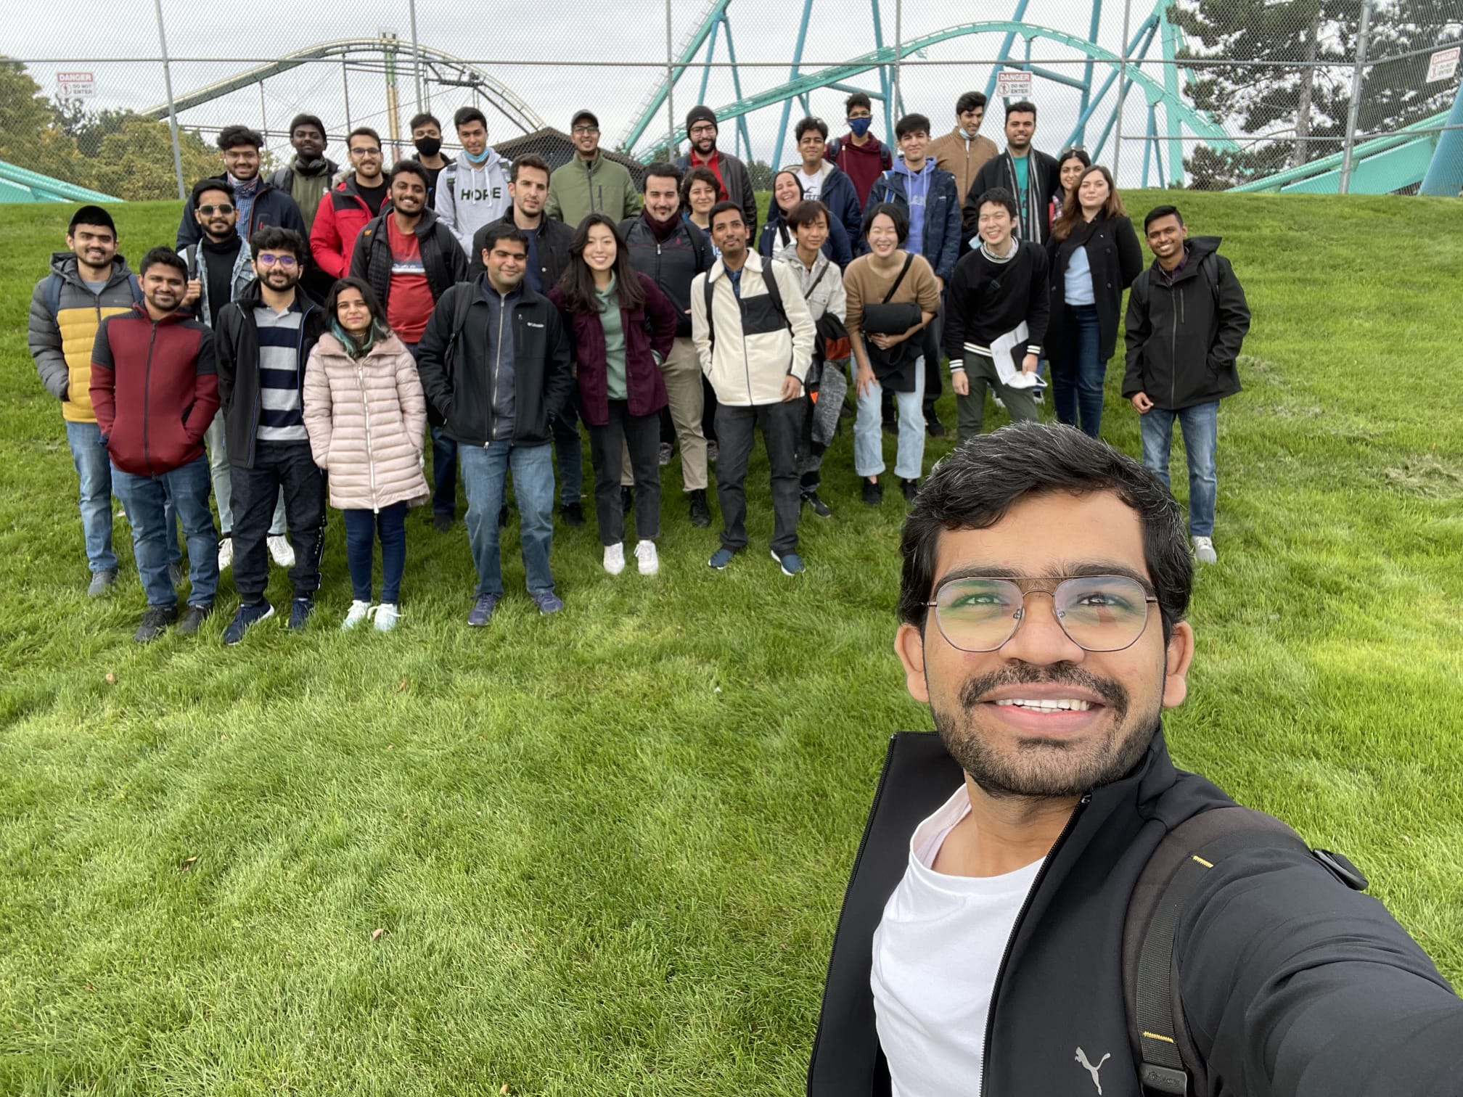
Fall Activities
Picnics, Wonderland, Welcome BBQ Event, Coffee Break Events, Distillery District etc. in Fall.
Welcome Back BBQ
Board Games Event
Toronto Island Picnic
Pizza Party
Wonderland Event

Slide 49
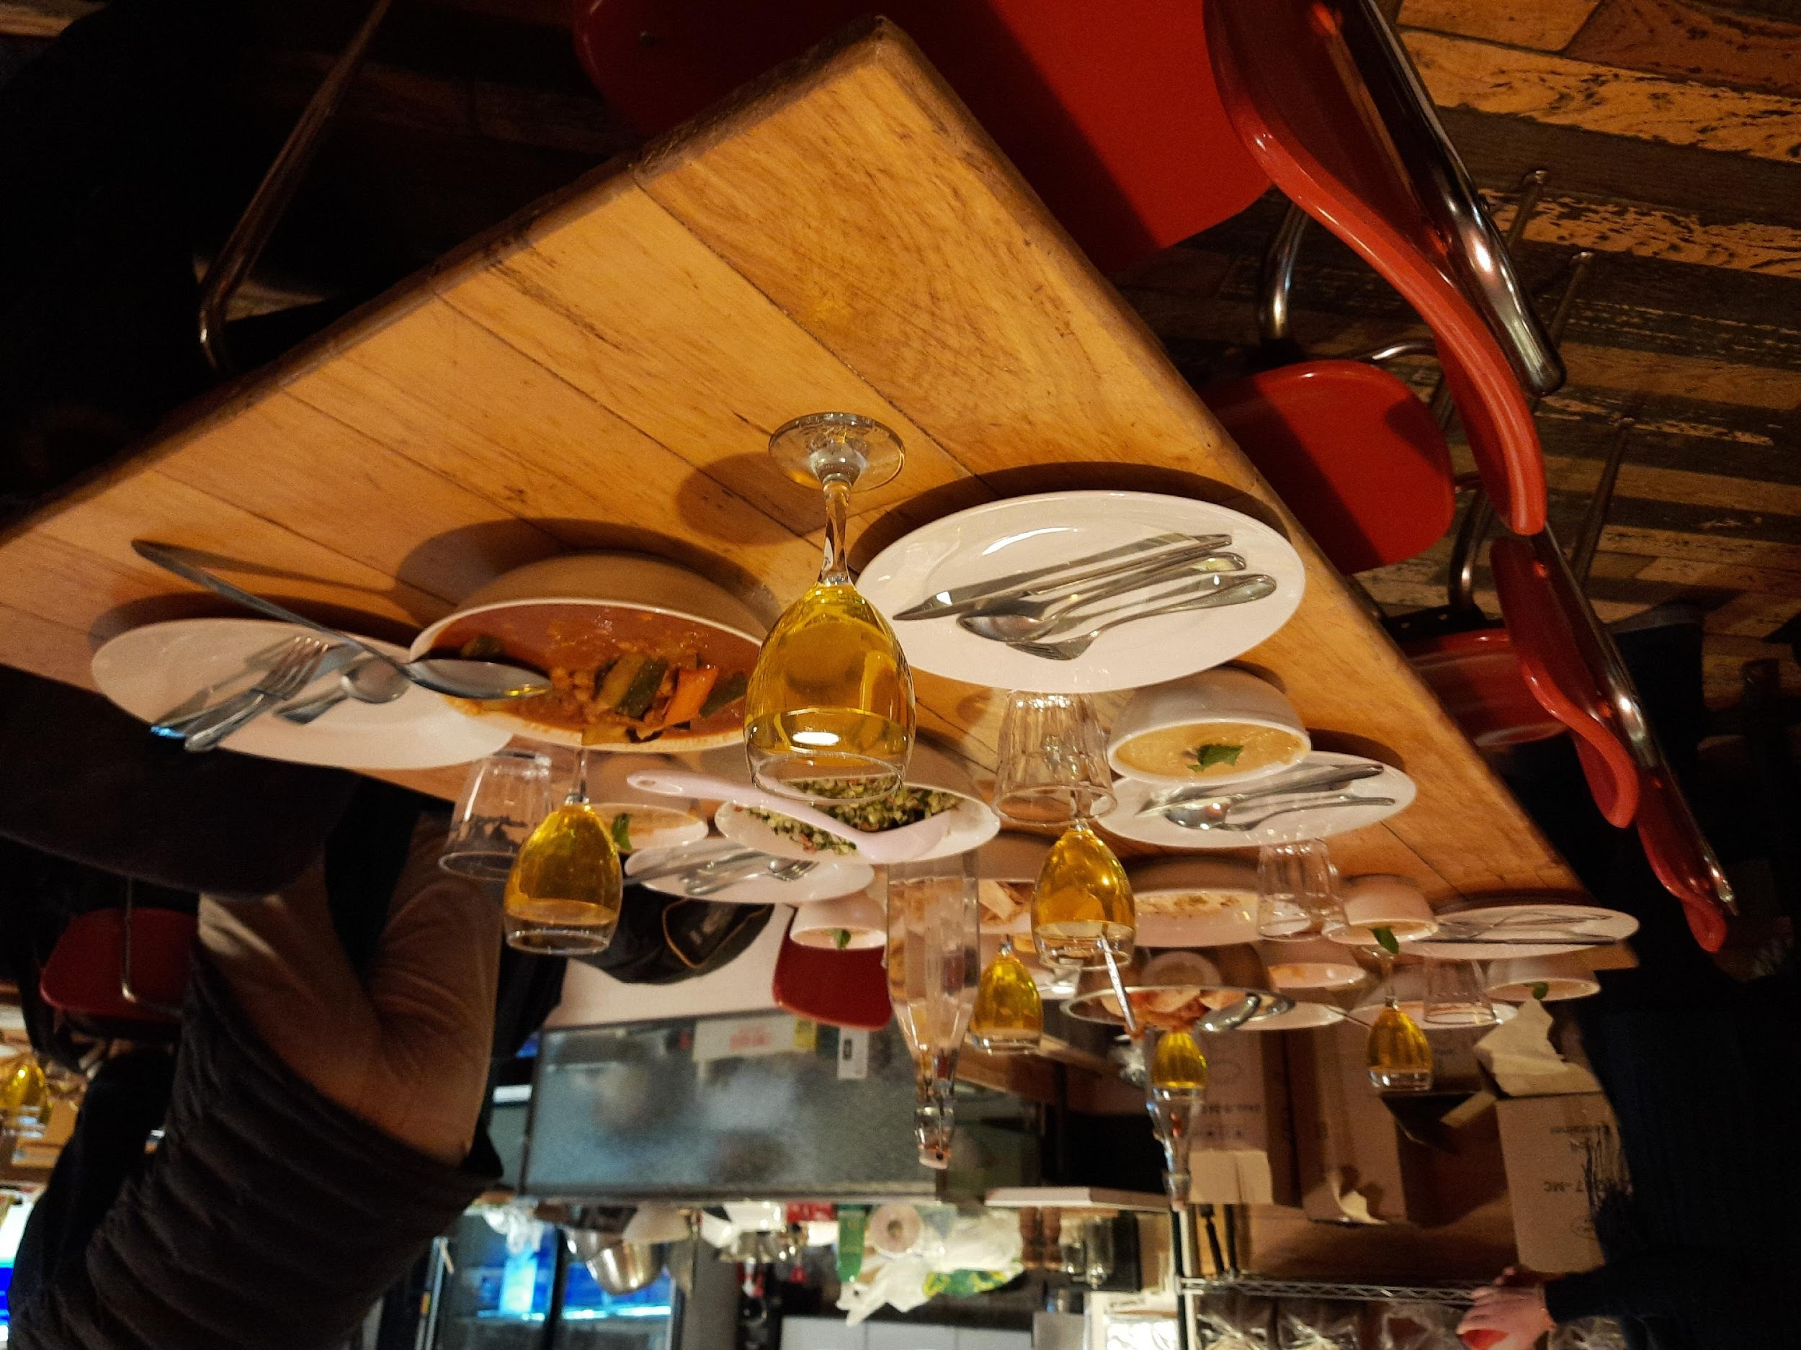
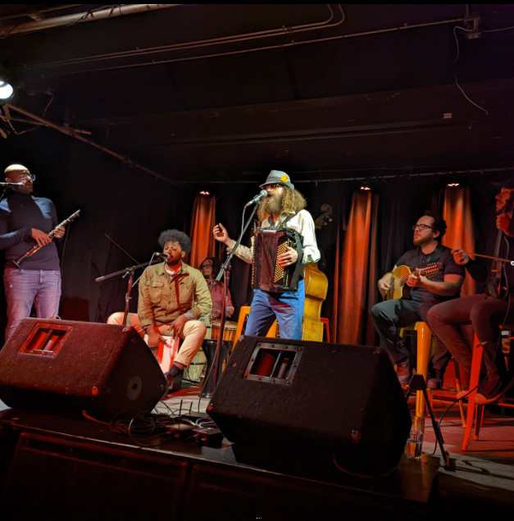
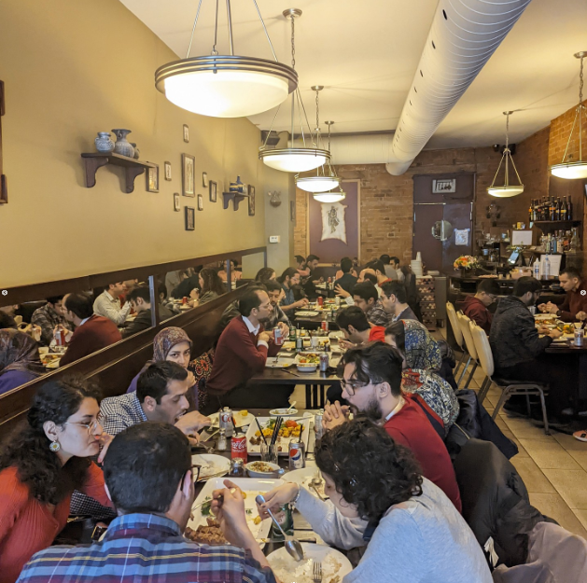
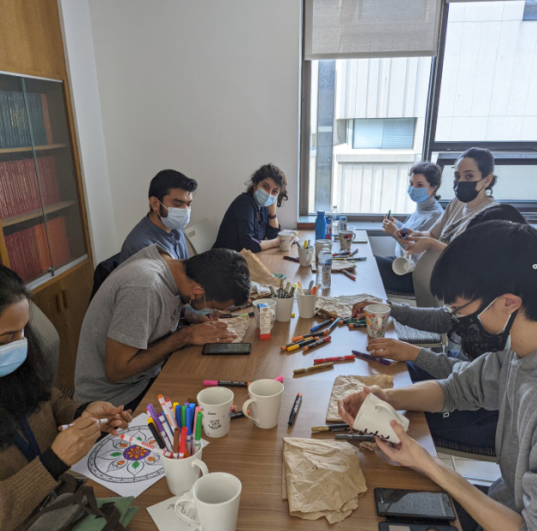

Winter Activities
Intercontinental Cooking Class, Persian New Year, Chinese New Year, Musical Event etc. in Winter.
Intercontinental Cooking
Musical Event
Persian New Year
Painting Event

Slide 50
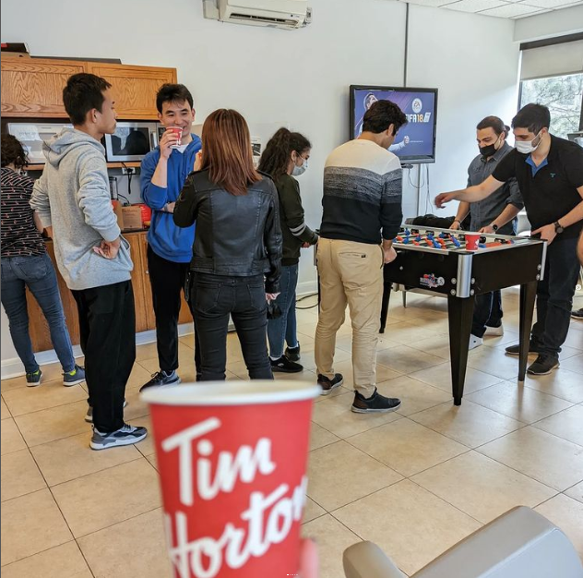
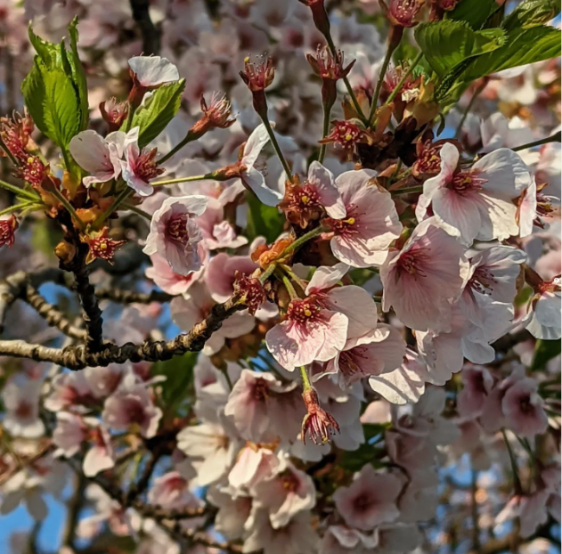
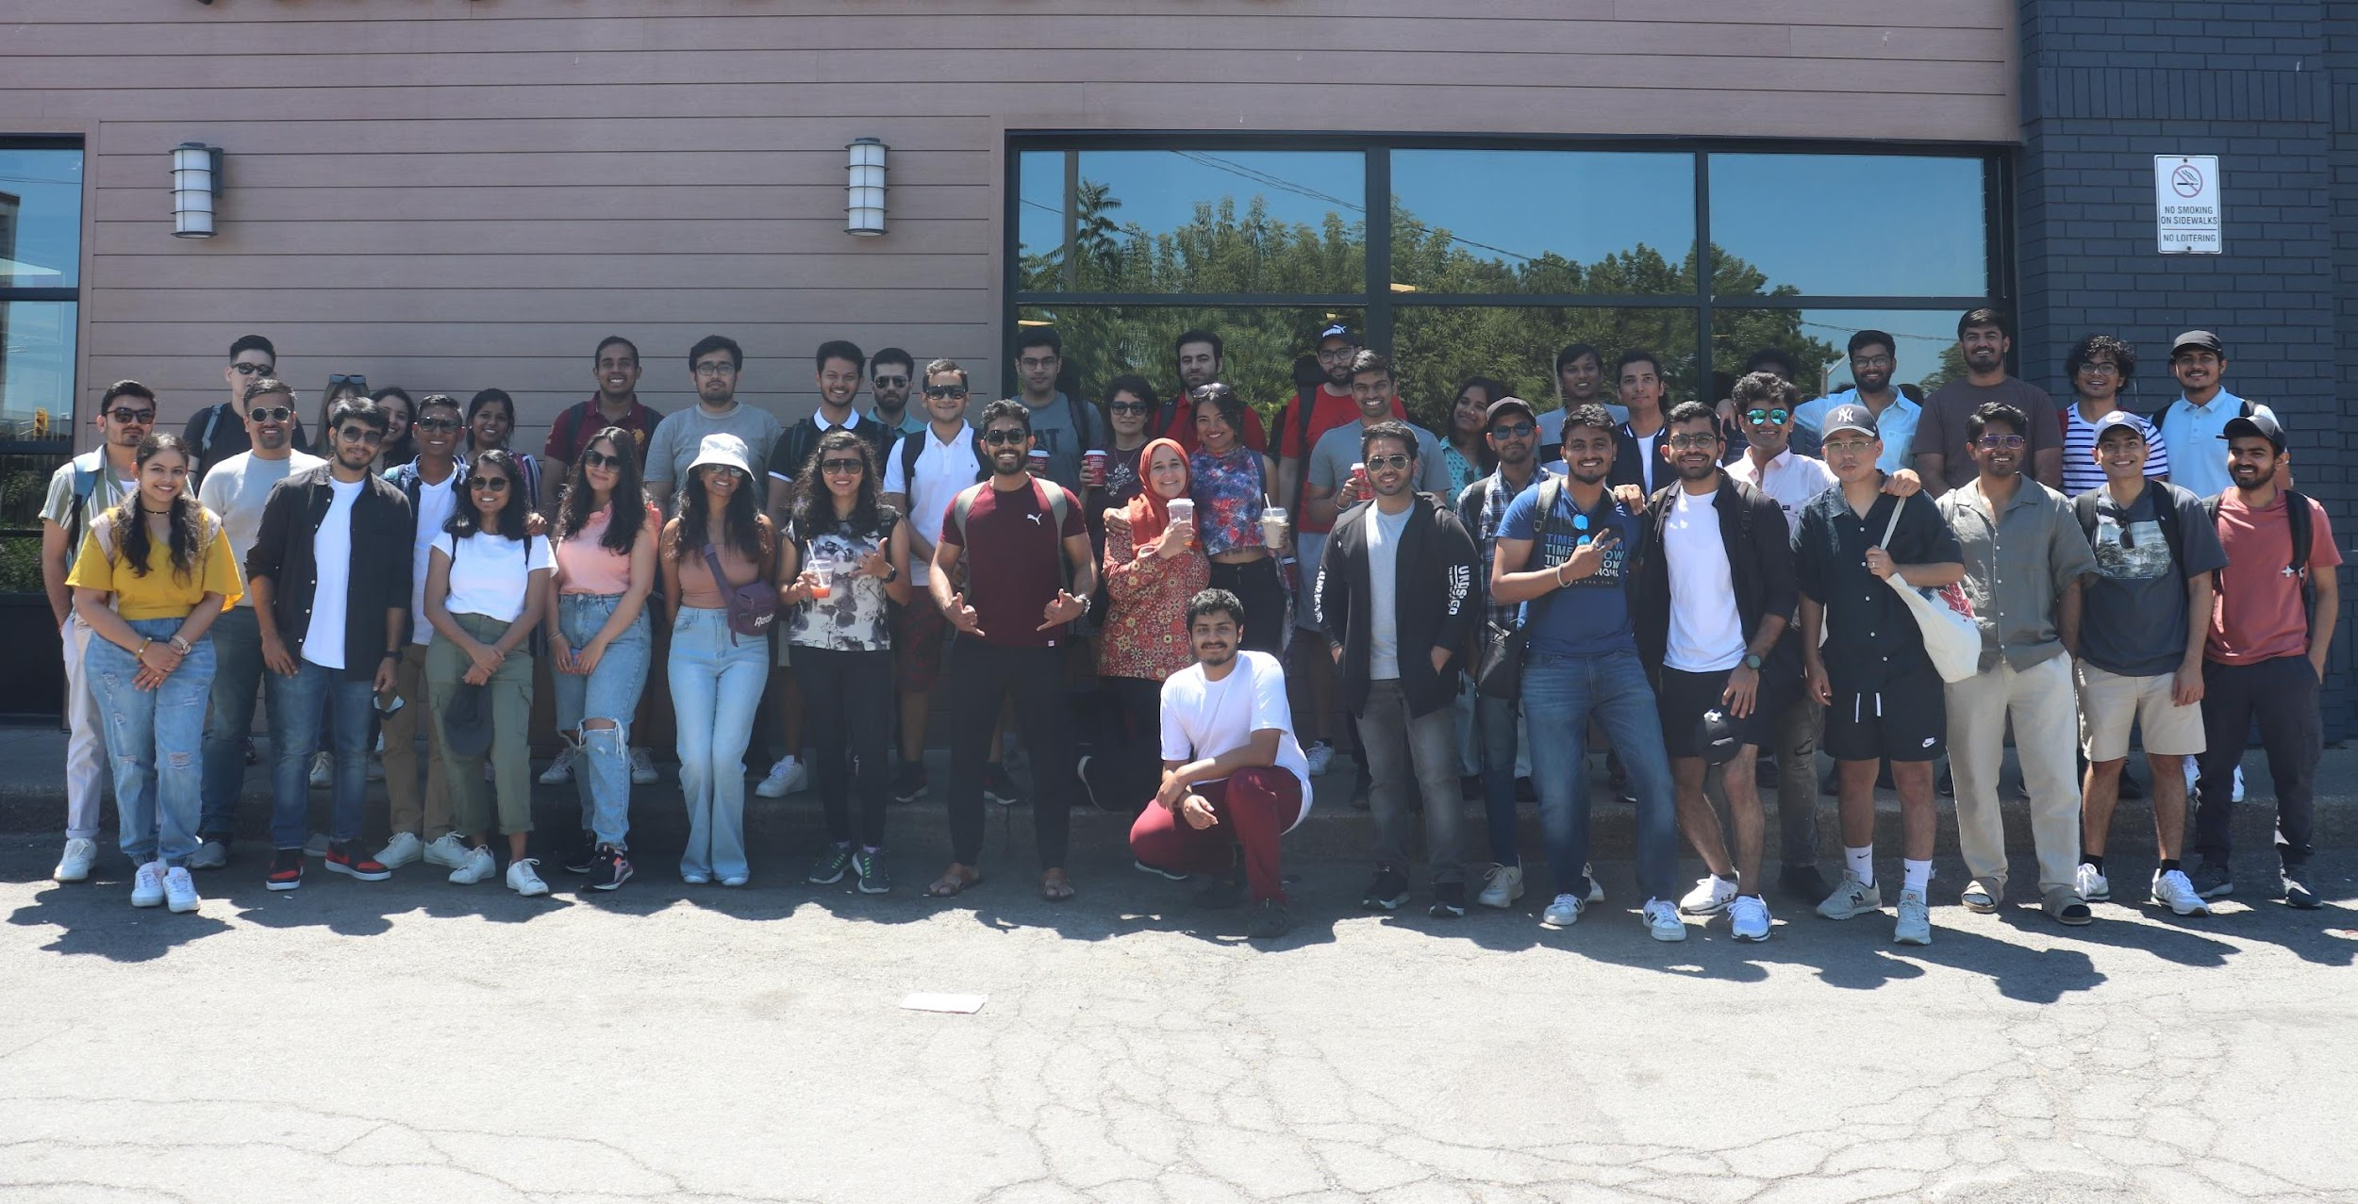

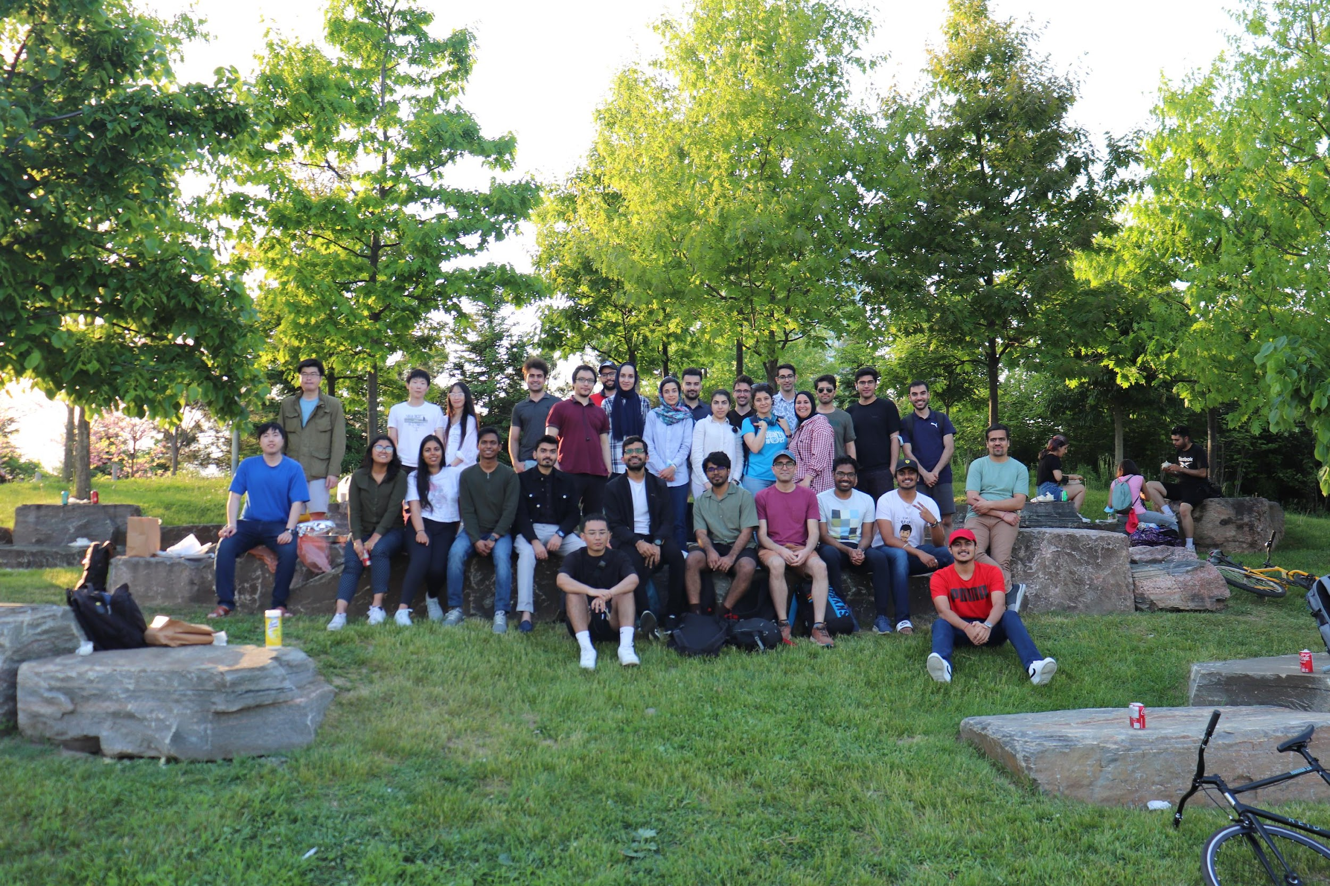
Summer Activities
Cherry Blossoms, Niagara Falls, Canada’s wonderland, Trillium Park Picnic, Trampoline Park Event, etc. in Summer 2022.
Coffee Break Event
Cheery Blossom Event
Niagara Falls Event
Persian New Year
Trampoline Park Event
Trillium Park Picnic Event

Slide 51

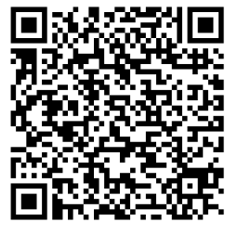
The social events do not end here ..
Welcome Back Event with the Taste of the Pongal (5$/ticket)
Friday, January. 19th starting at 6 pm
Notes:
Keep an eye on the newsletter, family-friendly, free

Slide 52
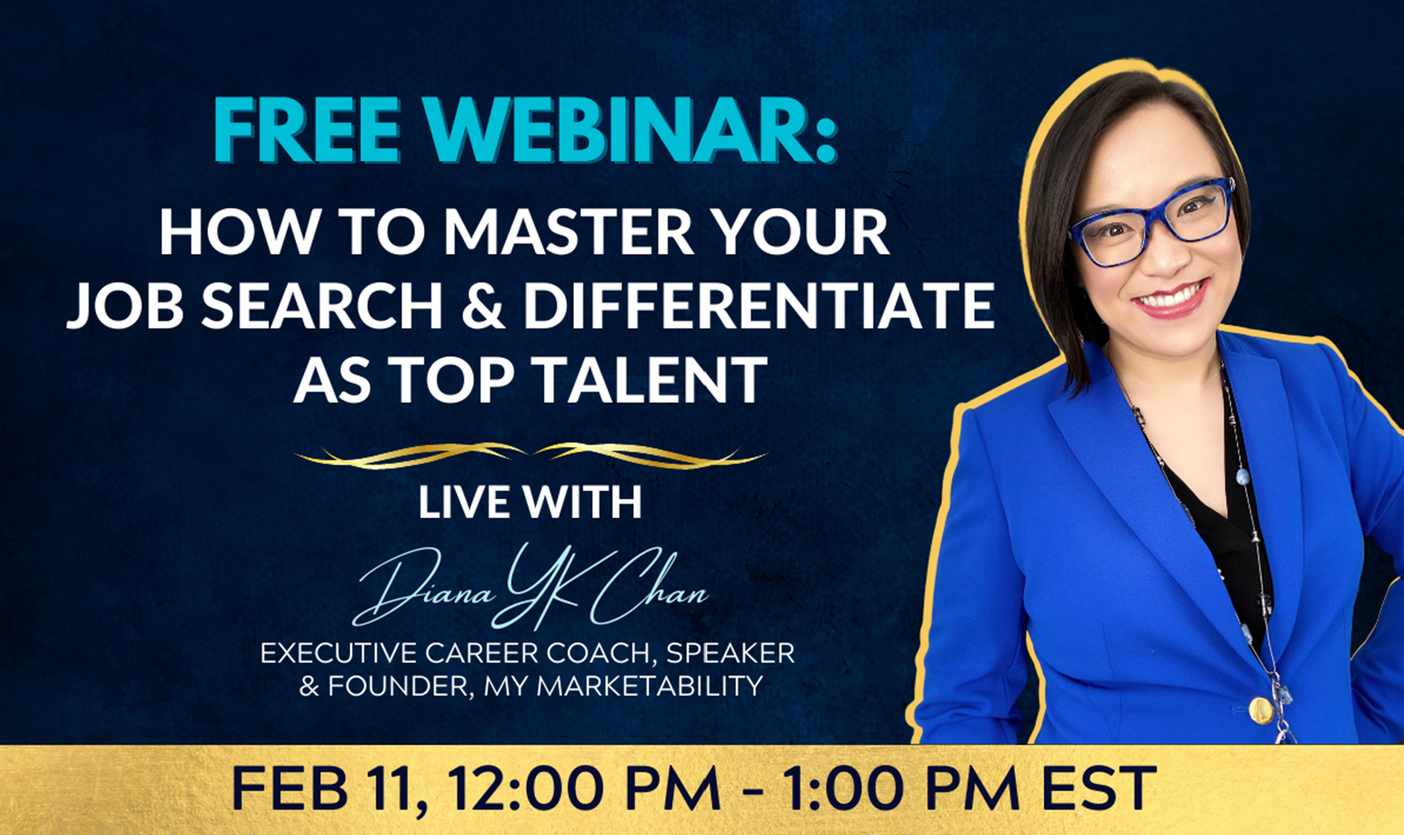

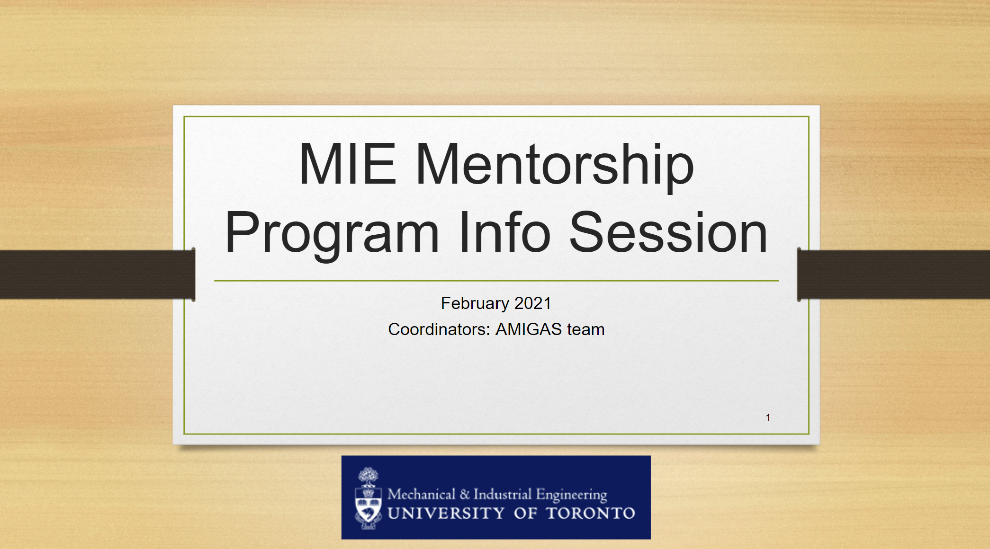

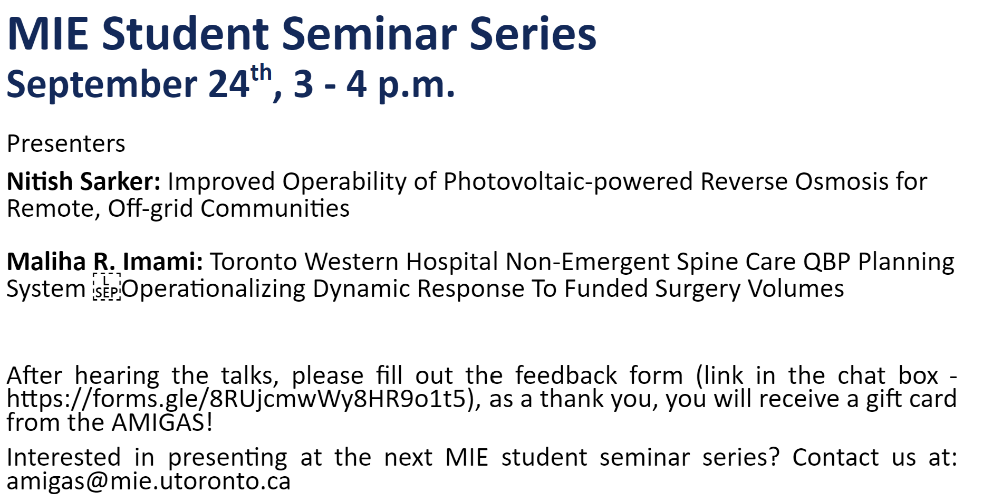
Academic and Professional Development Activities
Student seminar series and mentorship program
Professional development events: Networking, Alumni Event and Job Search events
Master you job search!
Networking with LinkedIn!

Slide 53
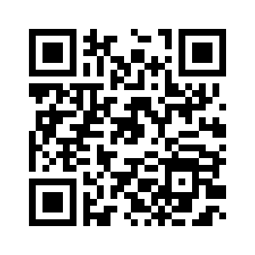

The professional events do not end here ..
Resume & Cover Letter Workshop (Career Exploration and Education)
Friday, January. 26th starting at 12:30 pm-Lunch will be offered
Notes:
Keep an eye on the newsletter, family-friendly, free

Slide 54
Interested in joining AMIGAS as an executive???
We run our summer elections in May. Stay tunned ;)
Conditions for becoming an exec:
  Be a full time or part time Gard student at MIE for this academic year (2024-2025).

Slide 55

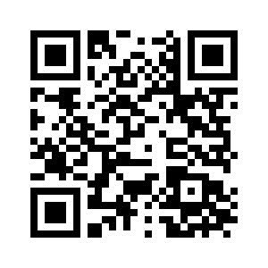
Stay In Touch
The best way to stay in touch is to follow our Instagram Page and our Weekly Newsletters.
Make sure to add our email
amigas@mie.utoronto.ca
to your trusted contact!

Slide 56
Thank you!
Questions?

Slide 57
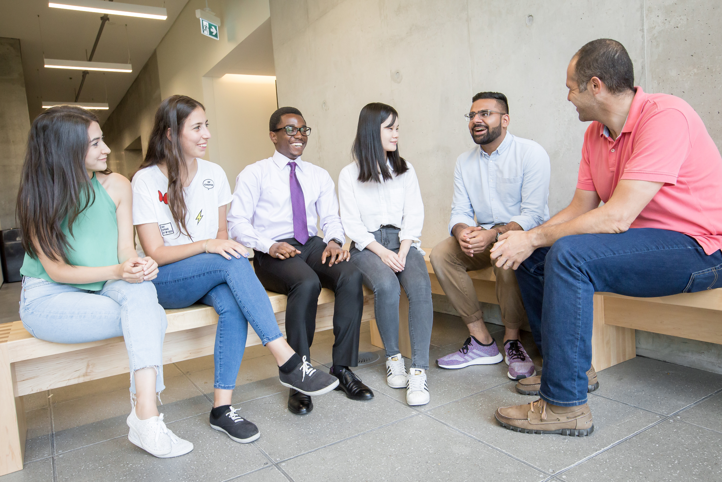

Graduate Programming
Notes:
Hello and welcome to U of T Engineering. My name is Joanne Lieu I work with the Vice Dean, Graduate Studies to support the professional development of graduate students and postdoctoral fellows.
I offer a number of programs to help you
Get involved in school beyond your courses and research
Meet new friends and build community
Develop skills that will support you at school and beyond

Slide 58

Navigate Your Degree
With Grad Maps
Develop your professional skills
Connect with you peers and mentors
Build your professional network
Launch your career plan
Notes:
With many programs and services to choose from, it can be difficult to know where to get started. Grad maps offers guidance on navigating your graduate degree to help you
Develop your professional skills
Connect with you peers and mentors
Build your professional network
Launch your career plan
Screenshare Grad Maps

Slide 59

Notes:
The OPTIONS Program supports you to explore diverse career pathways. It consists of two parts: a cohort program and complementary events.

Slide 60
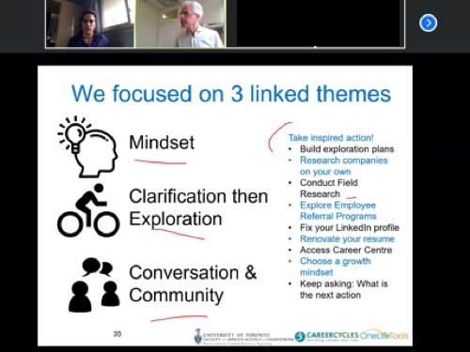
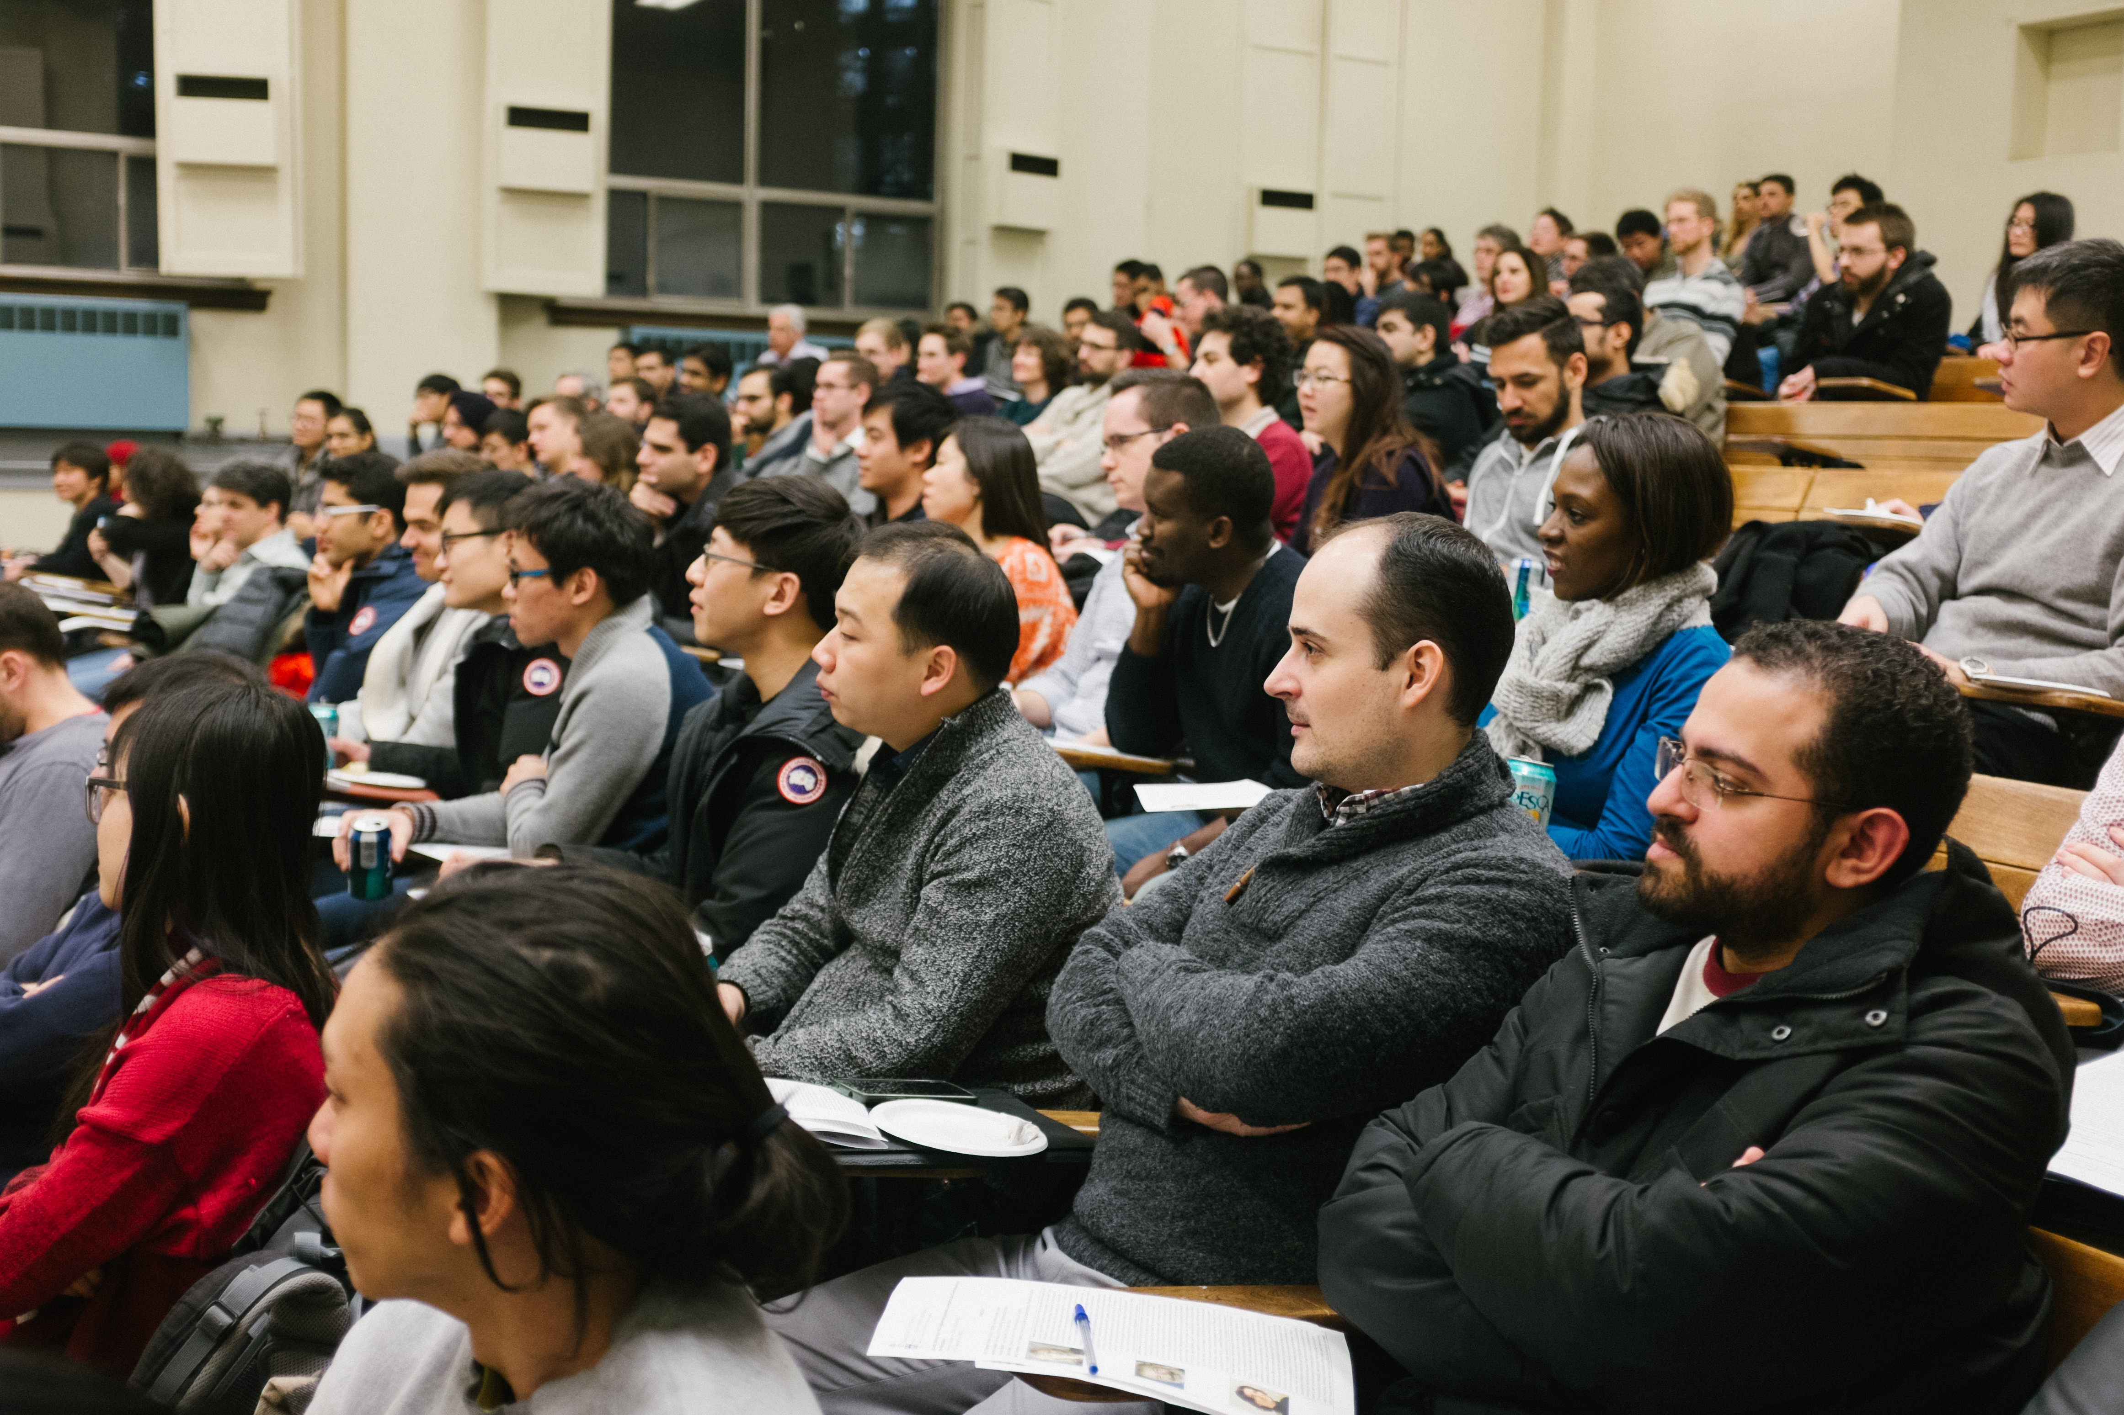
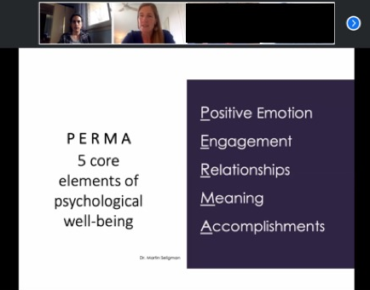
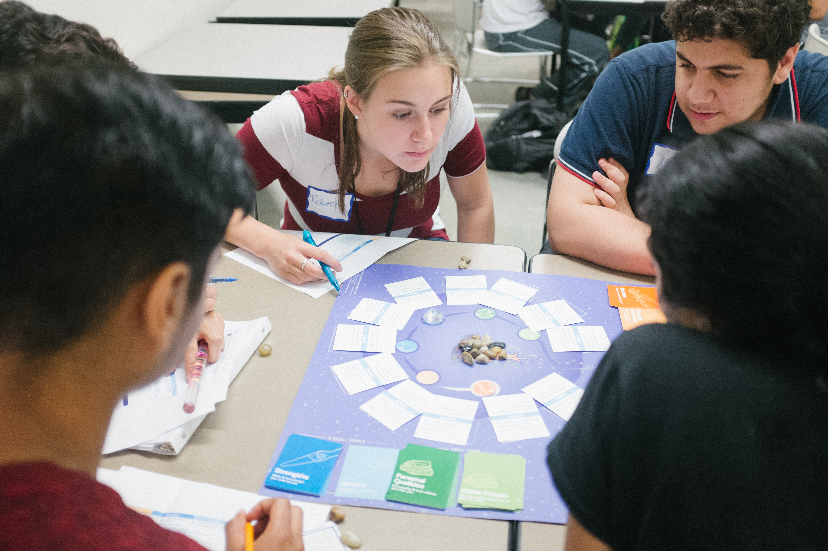
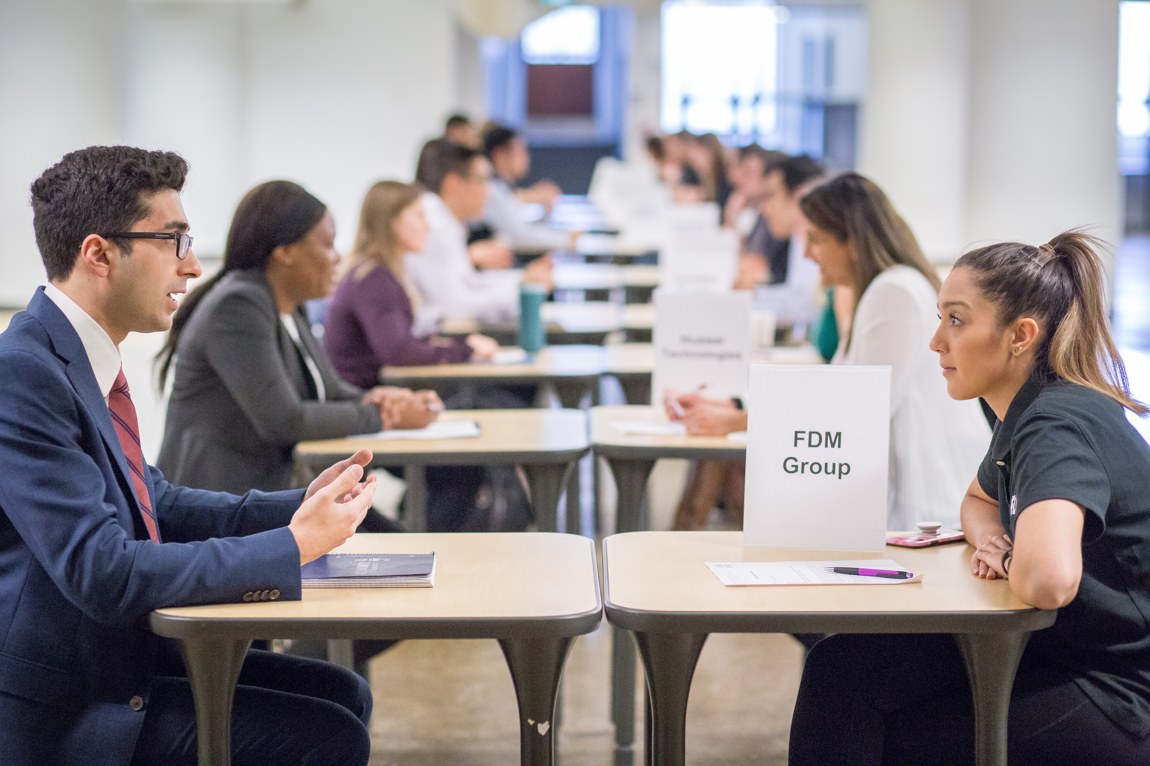
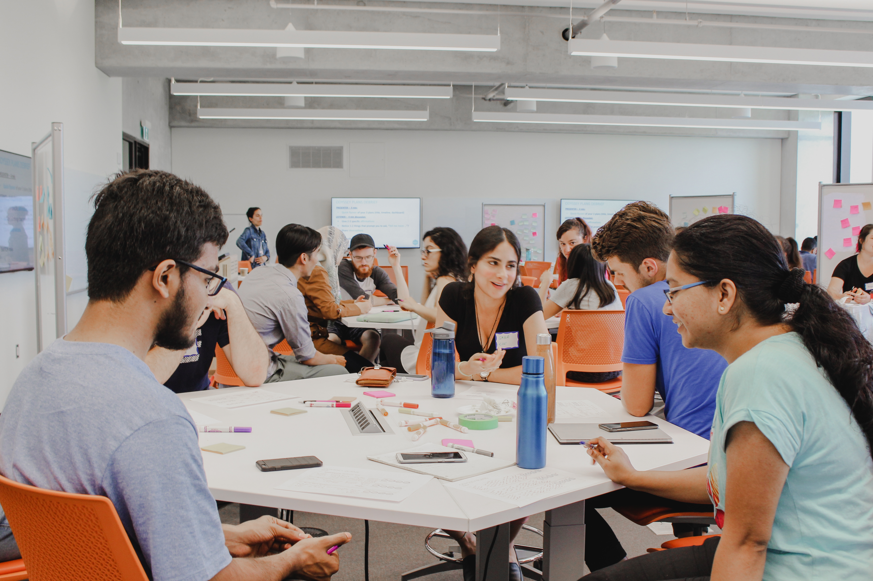
Complementary Events
Notes:
In addition to the Cohort Program, we host complementary events throughout the year. These are 2 hr to full day workshops that support you in developing skills crucial to your success as a student and professional.
Some examples of events that are coming up this year include:
Building a Better Relationship with Your Writing
Resume and Cover Letter for Industry
Tailoring Your Job Application: Using Networking, ATS, and AI to Your Advantage

Slide 61
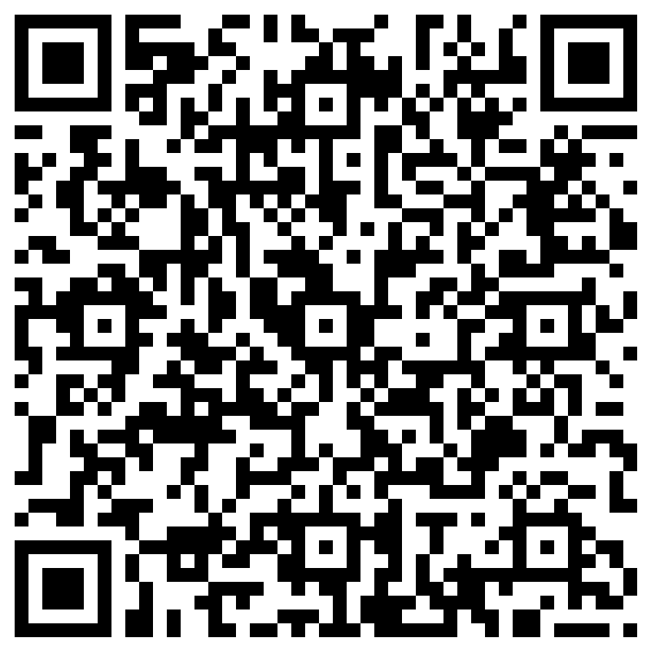
Creating Effective and Engaging Engineering Presentations
Tuesday, January 23
12:00 – 1:30 pm
GB202
Register in advance, pizza will be provided!
Notes:
...On Creating Effective and Engaging Engineering Presentations on Tuesday, January 23 from 12 – 1:30PM with Professor Lydia Wilikinson. Lunch will be provided, and you'll need to RVSP in advance.

Slide 62



LAUNCH YOUR CAREER PLAN
Friday, January 19 l 10:00 AM - 4:30 PM*
*Registration is now full, to be added to the waitlist please email grad.experience@engineering.utoronto.ca
Learn more at: uoft.me/lycp
Notes:
Launch Your Career Plan supports graduate students and postdoctoral fellows to launch their career planning early in their studies.
This event guides you to critically reflect on career opportunities including further graduate studies, academia, and industry, and equip you with strategies and tools to explore your unique career aspirations. You will leave this event with tailored resources to dive deeper into the specific career pathways that interest you.

Slide 63
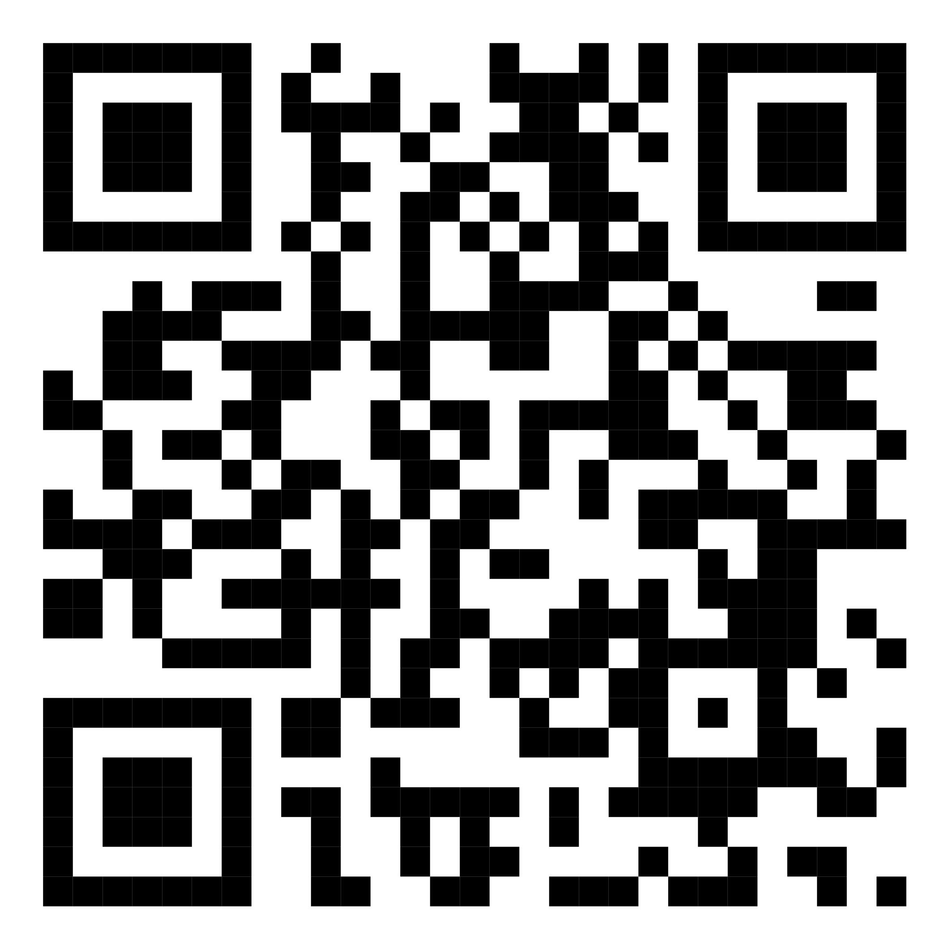
Learn more
uoft.me/FASEcurrentstudents
Questions? Contact
grad.experience@engineering.utoronto.ca
Notes:
Visit websites
Contact me
Scan QR code
uoft.me/optionsprogram

Slide 64
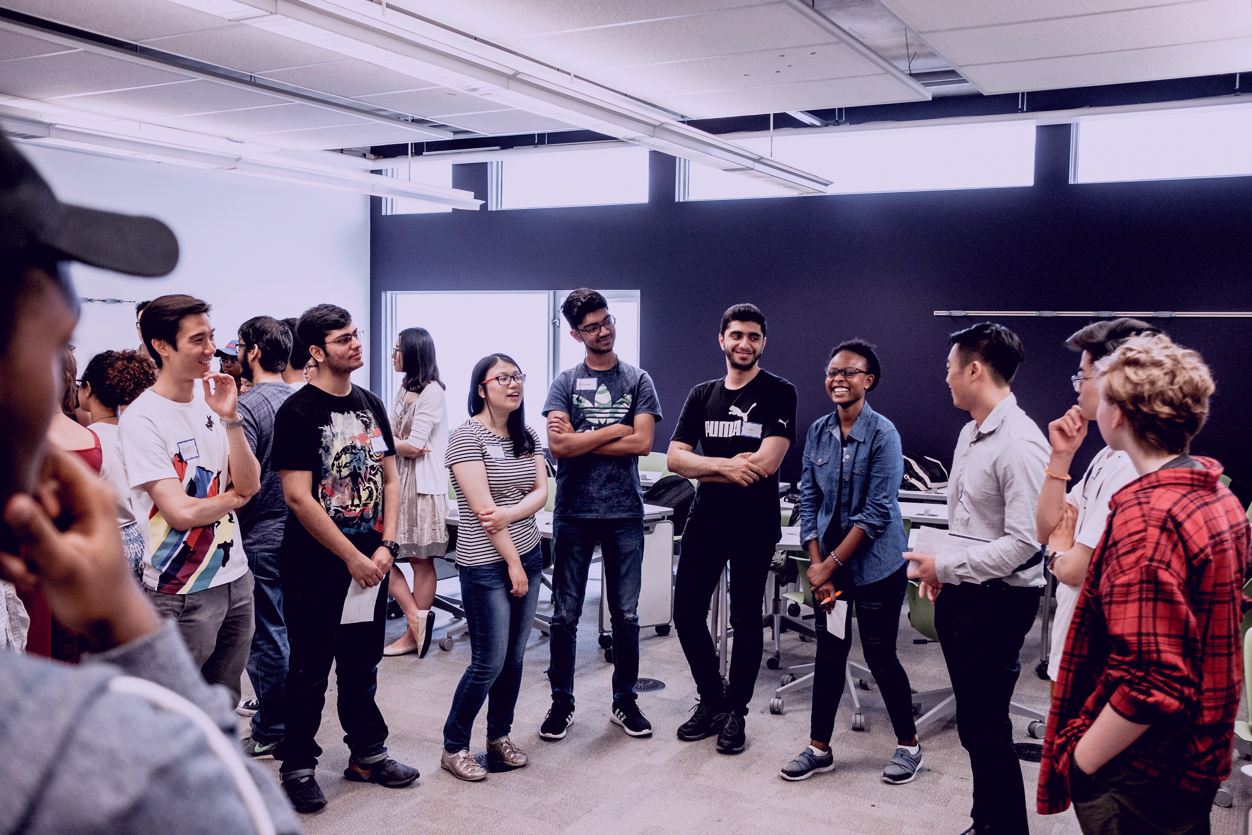
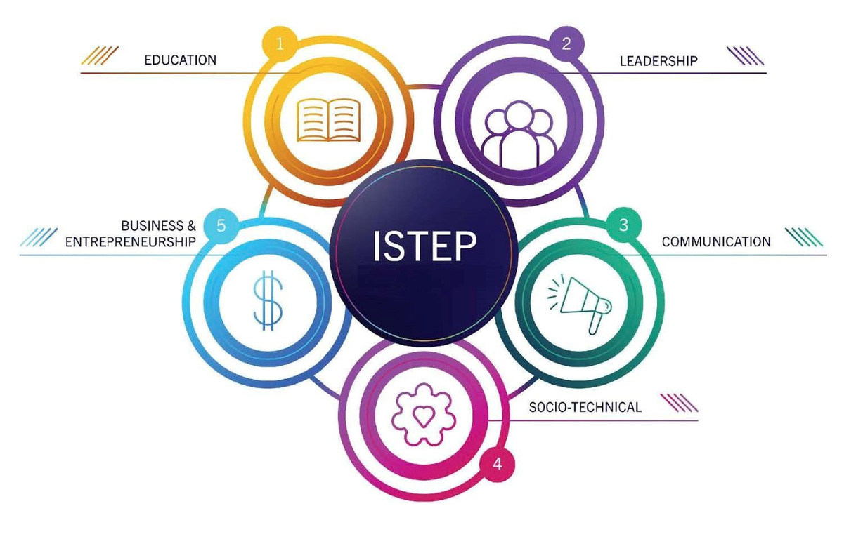

Become the engineering leader
the future needs.
Notes:
At U of T Engineering, we also have the Institute for Studies in Transdisciplinary Engineering Education and Practice, also known as “ISTEP for short”. ISTEP offers innovative academic programming and research to create a vibrant and engaging learning experience for students across the Faculty.
ISTEP has experts who focus on skills you need to be successful in your engineering education and future career: how to work in teams, how to write and present effectively, how engineering interfaces with business and society, and how to support your lifelong learning journey.
Our department is composed of multiple units that offer thematic programming and courses. This includes units that you may already be familiar with or will be soon introduced to – the Engineering Communication Program (ECP) and Troost ILead.
Both of these units are here to catalyze personal development, interpersonal development and professional development.

Slide 65

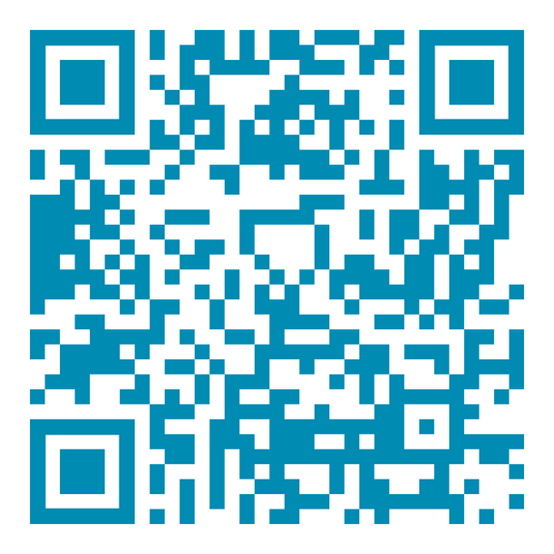
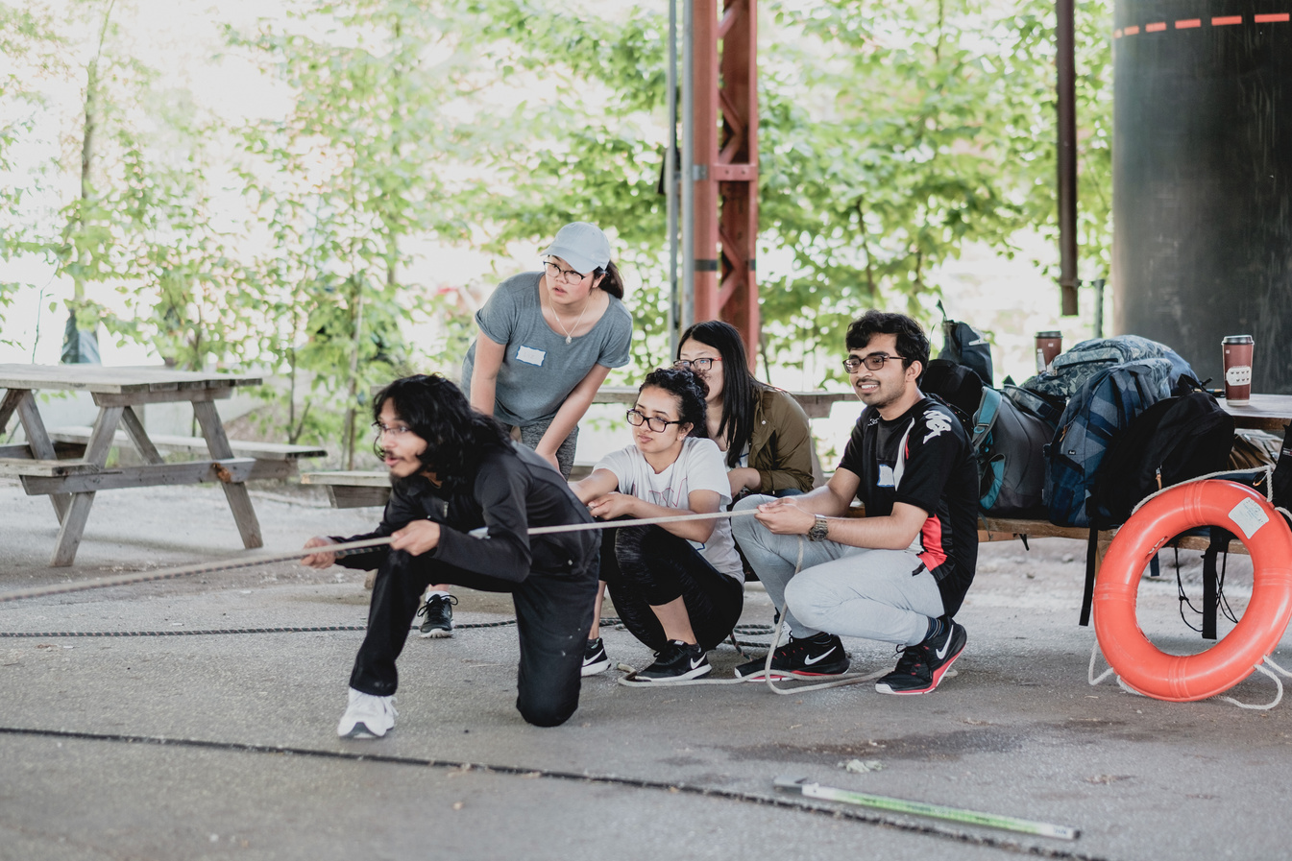
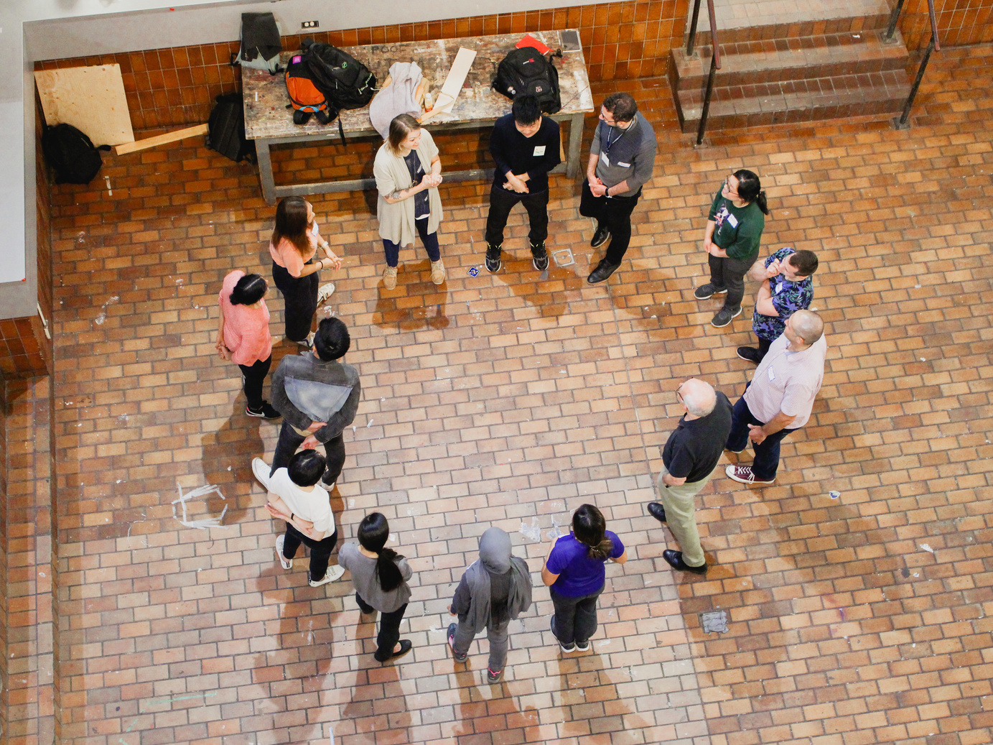
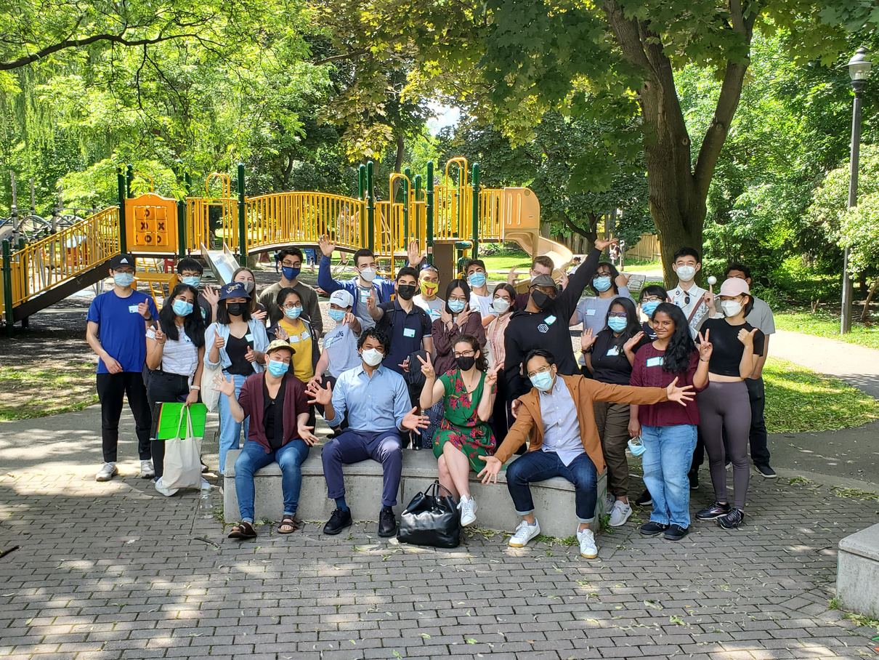
Courses, workshops, programs, and more!
Visit uoft.me/ileadstudents to learn more and
sign up for our newsletter!
Notes:
ISTEP offers:
The graduate TEP courses that count towards the ELITE Emphasis. Some of our more popular courses include “The Happy Engineer”, “Engineering Presentations”, and “Leadership and Leading in Groups and Organizations”;
In addition, we offer a range of co-curricular programming and support services such as the Graduate Communication Initiative; a fellowship program for club leaders; and ILead: Grad.
For more details on this and other upcoming events and programs, scan the QR code to sign up for our newsletter, visit uoft.me/ileadstudents, check out our event calendar on our website, sign up for our e-newsletter, or follow us on
Instagram.

Slide 66
Questions?

