Slide 1
Welcome, MIE Graduate Students!
Orientation Day – Winter 2020
Department of Mechanical and Industrial Engineering (MIE)
Friday, January 10th, 2020

Slide 2
Welcome!

Slide 3
MASc, PhD Studies in MIE
Prof. Murray Thomson
Associate Chair of Grad Studies
2020

Slide 4
Graduate Office Support Staff | MC108
Celeste Francis Esteves, Graduate Program Administrator
PhD/MASc student support
Funding related questions
Academic advising
Processes graduation requirements for all Graduate Programs
celeste@mie.utoronto.ca
Jho Nazal, Graduate Program Assistant: PhD/MASc
PhD/MASc admissions officer
PhD/MASc student support & adviser
Program & Course related questions
PhD annual milestones/meetings
jho@mie.utoronto.ca

Slide 5
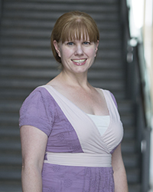
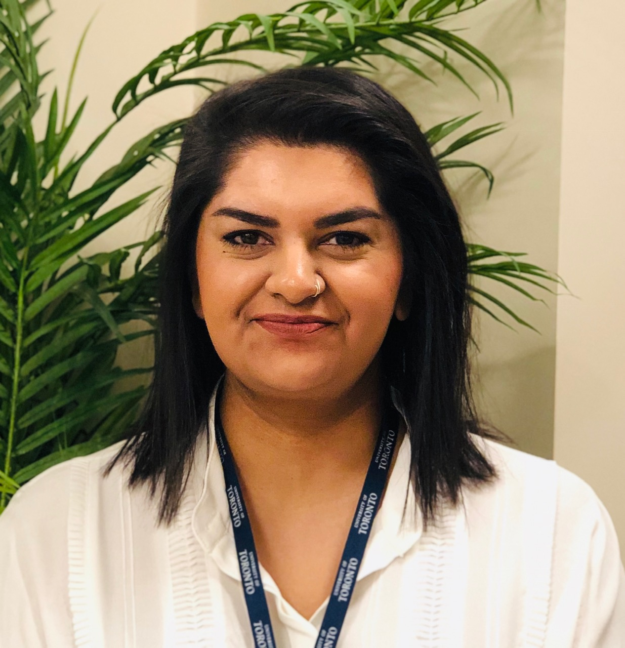
Graduate Office Support Staff
Kendra Hunter, Graduate Student Recruitment & Liaison
• Recruitment/marketing for all graduate programs at MIE
Scholarships
Web (graduate) content management
Non-degree admissions
hunter@mie.utoronto.ca
Aisha Mirza, Graduate Program Assistant: MEng
MEng admissions officer
MEng student support & adviser
aisha@mie.utoronto.ca

Slide 6
Graduate Office Services
Academic Advice
Course enrollment & course selection support
Graduation & degree checks
Funding information
PhD Program Requirements & timeline

Slide 7
Graduate Office Resources & Referrals
Health & Wellness
Learning Strategists
Math Aid & Writing Centre
International Transition Advisor

Slide 8
Degree Programs
MEng – Master of Engineering
10 courses or
7 courses + project
MASc – Master of Applied Science
4 courses
Thesis
Option to “fast-track” into PhD program within 1st year
PhD – Doctor of Philosophy
5 courses
Dissertation

Slide 9
MASc Requirements/Restriction
Requirements/Restriction for MASc:
Four graduate level courses:
Two must be from MIE
Only one reading course
Only one APS course
JDE1000H (Ethics in Research Seminar) in the 1st or the 2nd term of registration
Departmental seminar:
70% or more in the first two years
Bring your T-Card!
https://www.mie.utoronto.ca/wp-content/uploads/2016/06/MIE-Seminar-Series-Student-Guide.pdf
https://www.mie.utoronto.ca/events/seminars/

Slide 10
MASc: Beginning to End
1. Admission
Undergraduate degree
Transfer from M.Eng
2. Thesis Final Exam
Within 24 months
Thesis committee
Supervisor + 1 members
3. Completion
With degree
Convocation
Without degree
Termination
Withdrawal

Slide 11
PhD Requirements/Restriction
Five graduate level courses
Three must be from MIE
Only one reading course
Only one APS course
Only one 500-level course
JDE1000H (Ethics in Research Seminar) in the 1st or the 2nd term of registration
Distinguished MIE Seminar Series
70% or more in the first two years
Bring your T-Card!
https://www.mie.utoronto.ca/wp-content/uploads/2016/06/MIE-Seminar-Series-Student-Guide.pdf
https://www.mie.utoronto.ca/events/seminars/

Slide 12
PhD: Beginning to End
1. Admission
Master’s degree
Direct entry from Undergrad
Transfer from MASc
2. Qualifying Exam
Within 12 months of registration
Pre-requisites
Four courses or more with at least an A- average
Failure to meet the pre-requisites may lead to termination
Outcome may be termination
3. Progress Meetings
Every 12 months from registration
Outcome may be termination
4. (MIE oral) and SGS oral
5. Completion
With degree
Convocation
Without degree
Termination
Withdrawal

Slide 13
Good Academic Standing
Failure to maintain good academic standing may result in various sanctions, including ineligibility for financial assistance, lowest priority for bursaries and assistantships, and even termination.
Good Academic Standing in MIE
Attend Orientation Session
No FZ
Average grade A- or above.
Qualifying Exam within 12 months of registration
At least four courses to be completed
JDE/Ethics
MIE Seminar credits
Annual Phd Progress Meetings
Notes:
Importance of annual progress meeting
A requirement of SGS is that there must be a meeting at least once a year of the student and supervisory committee at which the student is expected to demonstrate satisfactory progress.
The supervisor and student may have a mutual unspoken understanding that such a meeting is not really necessary – until suddenly the supervisor becomes aware that the student is way behind in the research, decides this is not going to work out, and wants the student out of the program.
But this is unfair to the student—who should have received plenty of warning and had opportunities to improve performance—and unfair to the graduate unit, who may have been able to assist in various ways if they had known about a growing problem. Such problems can be minimized if expectations, including the regulations that must be followed, are made clear as early as possible in the program.

Slide 14
5. Time-to-Completion
Distribution of Phd Time-to-Completion in MIE since 2014

Slide 15
MIE PROGRAM REQUIREMENTS - Guide
See https://www.mie.utoronto.ca/graduate/graduate-programs/phd/doctor-of-philosophy/

Slide 16
MIE Graduate Student Management System
Mandatory for arranging Qualifying and Committee meetings
https://grad.mie.utoronto.ca/
New: Funding letter on GMS
Review and sign

Slide 17
Useful Information
Obtaining T-Card
Instructions: http://tcard.utoronto.ca
Need T-Card in order to obtain UofT email address
Updating Mailing Address and Email
The "utoronto" email account required to communicate with the Graduate Office.
A current and valid local mailing address on ROSI/ACORN
Graduate Office Hours
9:00 am - 4:00 pm on every weekdays but Thursday
10:00 am - 4:00 pm on Thursday
Student Requests
Student requests will be reviewed weekly, on Thursdays.
Notes:
Students should update their contact information both with ACORN and ROSI.

Slide 18
Clarifying Professor’s Expectations
Frequency and modes contact
How should non-scheduled communication be handled?
Where and when most of the work to be carried out?
Timing of major milestones: courses, paper submission, drafts of thesis, etc.
How and when will the thesis topic be decided upon?
The expected “turnaround time” on drafts of written materials?
If most research is to be done in a lab, what is the lab “etiquette?
Expectations concerning publications & conference presentations?
Notes:
Now that the supervisor has been determined, it is very important to build a good relationship. Maybe the first important step is to establish mutual expectation, or clarifying expectation.
SGS recommends that the most important and least flexible expectations should be set down in writing as a form of “contract” or “memorandum of understanding.” This could be as formal as an actual printed document signed by both parties, or as informal as an email summary of what was discussed at a meeting.
Such a document can serve as a useful reminder of what was agreed, and can be important if there are future problems. It should be revisited and updated periodically after discussion between student and supervisor.

Slide 19
Common Expectations from Supervisor
As a full-time student, you are required to spend a significant number of hours on academic works such as courses and research.
Since your supervisor is providing Research Assistantship, you are recommended to consult with your supervisor before accepting TA positions.
If you will have to be away, you will have to consult with your supervisor prior to your away to avoid any disruption to the research project you are engaged. This is especially important when you travel internationally.
Failure to maintain good academic standing may result in various sanctions, including ineligibility for financial assistance, lowest priority for bursaries and assistantships, and even termination

Slide 20
Some Supervisor May Expect….
You will have to consult with the supervisor before applying for any TA positions.
You are required to be in the lab physically.
You will have to bring a written document, summarizing the progress since last meeting, to every research meeting.
You are entitled to have two weeks (or 10 business days) off without sacrificing stipend. However, you will have to consult with the supervisor about the timing at least two weeks in advance.
Notes:
The research assistantship position you will hold throughout the studies is in a sense an employment, which is full time. That is, you are the full-time employee and your supervisor, who is responsible for monthly payment, is the employer. As a paid employee, there are responsibilities you hold with your employer. Given that, you will have to consult with your supervisor when you get additional duties that might impact on your employment. This may involve, but not limited to, application to teaching assistantship, trip stretching over multiple days, international trip for sure, where to work, etc.

Slide 21
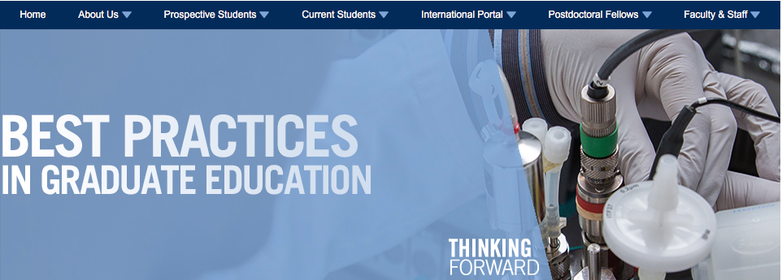
Good Practice on Graduate Supervision
https://www.sgs.utoronto.ca/resources-supports/gpd/gps/research-related-skills-offerings/
Please note: the SGS website is currently being updated. Some resources may not be visible at this time.
https://www.sgs.utoronto.ca/wp-content/uploads/sites/253/2019/06/Graduate-Supervision-Guidelines_Students.pdf
https://www.sgs.utoronto.ca/wp-content/uploads/sites/253/2019/06/TTC-Best-Practices_Students_SGS.pdf

Slide 22
Research at an External Partner
External partner = industry, government, hospital or non-profit
Students located at external partners should have a document signed by all parties that outlines everyone’s expectations (i.e. external partner, student and university/professor).
Students located at an external partner should contact the Associate Chair of Grad Studies to discuss

Slide 23
Useful Dates
Deadlines
January 20 Registration (late registration fee charged after this date)
1. Clear outstanding admission conditions if any
Change the status from INVIT to REGISTER on ACORN by paying/deferring fees
Enroll in courses & update (local) contact/bank information on ACORN
January 15 Final Day to Add Reading Course
January 20 Final Day to Add full-year and Fall courses*
• Reading Course Add deadline earlier: January 15
February 24 Final Day Drop courses without academic penalty*
* Research students need supervisor’s approval for add/drop courses
Notes:
Please drop the courses as soon as you decide so that students in the waitlist can get in!

Slide 24
Useful Links
Stay in Touch:
Grad Announcement: http://board.mie.utoronto.ca/viewforum.php?f=2
MIE Grad Home: http://www.mie.utoronto.ca/graduate/
Resources on line:
Sessional Dates: https://sgs.calendar.utoronto.ca/sessional-dates
SGS Calendar https://sgs.calendar.utoronto.ca/
Forms in MIE: http://www.mie.utoronto.ca/graduate/forms/
Forms in SGS: http://www.sgs.utoronto.ca/currentstudents/Pages/Student-Forms-and-Letters.aspx
Fees: http://www.fees.utoronto.ca/
MIE Grad Courses: http://www.mie.utoronto.ca/graduate/courses/
APS Courses: http://gradstudies.engineering.utoronto.ca/meng/elite-certificate/

Slide 25
Health and Safety
Safety Training
Annual online safety training is mandatory for all MIE students, faculty, researchers, and visitors.
Joint Health & Safety Committee
Please direct any safety-related inquiries and concerns to the Joint Health & Safety Committee.
Contact: safety@mie.utoronto.ca
Emergency services should be contacted in the case of immediate danger.

Slide 26
Scholarship Opportunities
Those unable to attend a workshop can view the slide presentations on the SGS website after September 24.
Deadlines:
See http://www.sgs.utoronto.ca/currentstudents/Pages/Scholarships-and-Awards.aspx
Fall: Vanier, NSERC, SSHRC, CIHR, named MIE
Winter: OGS
Graduate Award Information sessions
Federal: Vanier, NSERC PGS-D, SSHRC CGS, PDF
Provincial awards: OGS
Dates and times of award information sessions are posted on SGS website
Dates: TBA
Location: TBA
Those unable to attend a workshop can view the slide presentations on the SGS website after the session.

Slide 27
www.nytimes.com/2018/08/17/opinion/college-students.html

Slide 28
Student Life & Resources
MIE Graduate Resources
http://www.mie.utoronto.ca/graduate/gradresources.php
Contains useful resources for MIE grad students
Getting Involved: Student organizations (MIE student groups, campus-wide)
Professional Development
Student Life: Academic Success Centre, International Student Centre
Access to Graduate Lounge: MC330 – Code is 1589

Slide 29
Professional Development
School of Graduate Studies (SGS)
Institute for Leadership Education in Engineering (ILead)
MIE & Student-Run Workshops
Preparing for Academic Careers
Preparing for Industry Careers
See https://www.mie.utoronto.ca/graduate/graduate-opportunities/professional-development/

Slide 33
Learn more
uoft.me/optionsprogram
uoft.me/gradpacs
Questions? Contact: Teresa Didiano t.didiano@utoronto.ca

Slide 34
Being Connected!

Slide 35
Any Questions?

