Slide 1
Introduction
Mitchell Beacom
4th Year Mechanical Engineer Student
MIE Exchange to Lund University, Sweden
Winter Semester 3rd Year

Slide 2
Why go on Exchange?
Great Experience
Self - Development
Academic / Career

Slide 3
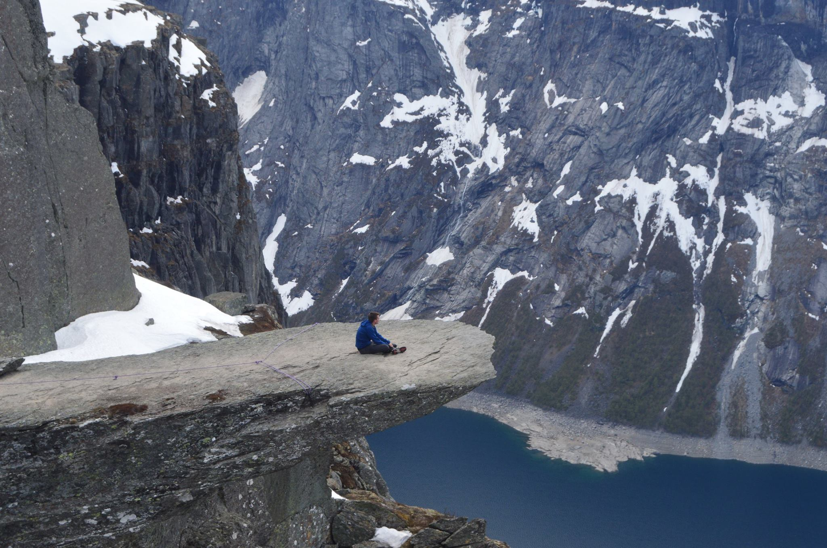
Great Experience
Experience a new environment
Learn about another culture
Meet new people
Choose anywhere
Take on new experiences
Exchange student community
Travel and Exploring

Slide 4
Self-Development
Learn to adapt to new environments
Develop skills for international study and work
Language skills
Gain confidence to pursue future challenges

Slide 5
Academic & Career
Academic:
Balance the benefits of what is offered at another university with UofT
Study specialized topics
Gain flexible access to other facilities or programs
Masters & Career:
Expand network and opportunities
Highly regarded for admissions and recruitment

