Slide 1
Summer Exchange -NUSIP
Mengyan Wang

Slide 2
NUSIP
Summer Intensive Program at Nagoya University
Elementary Japanese Language Classes
Seminars on Latest Advanced Technology and Tasks in Automobile Engineering
Autonomous Driving
Drivers’ Behavioral Study
Computer Embedded Systems
Electric Vehicles and Fuel Cell Vehicles
Automobile Industry Factory and Laboratory visits
Toyota, Honda, Mitsubishi, Suzuki, Yokohoma Rubber
Cultural Excursions

Slide 3
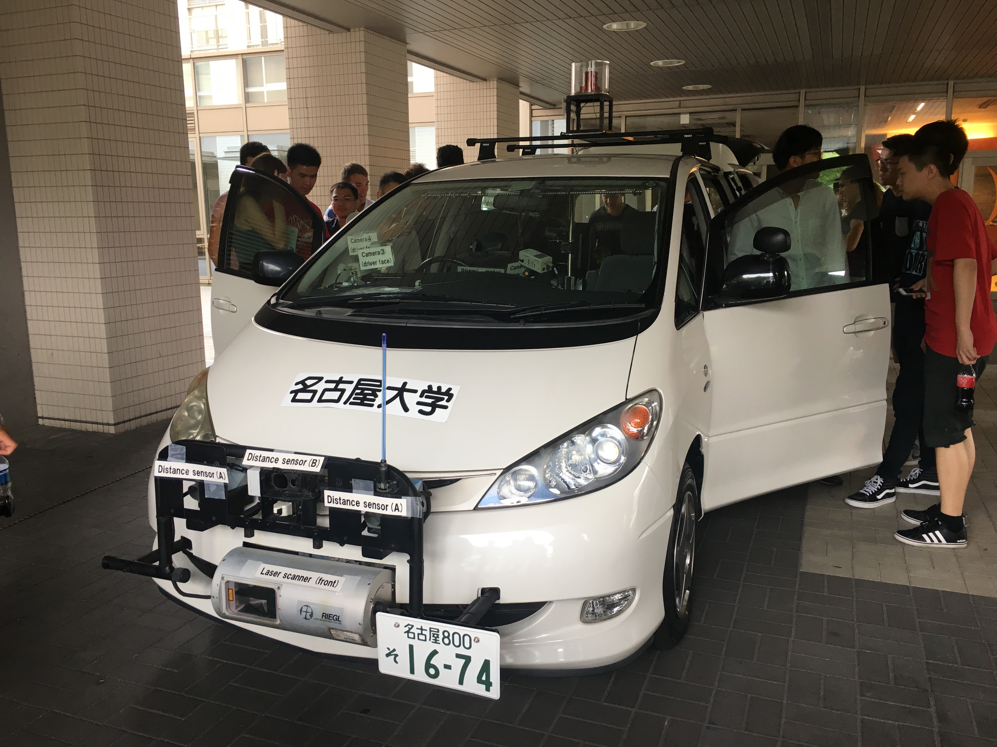
Why Summer Exchange? - Perspectives
Multi-perspective
Widen your horizon

Slide 4
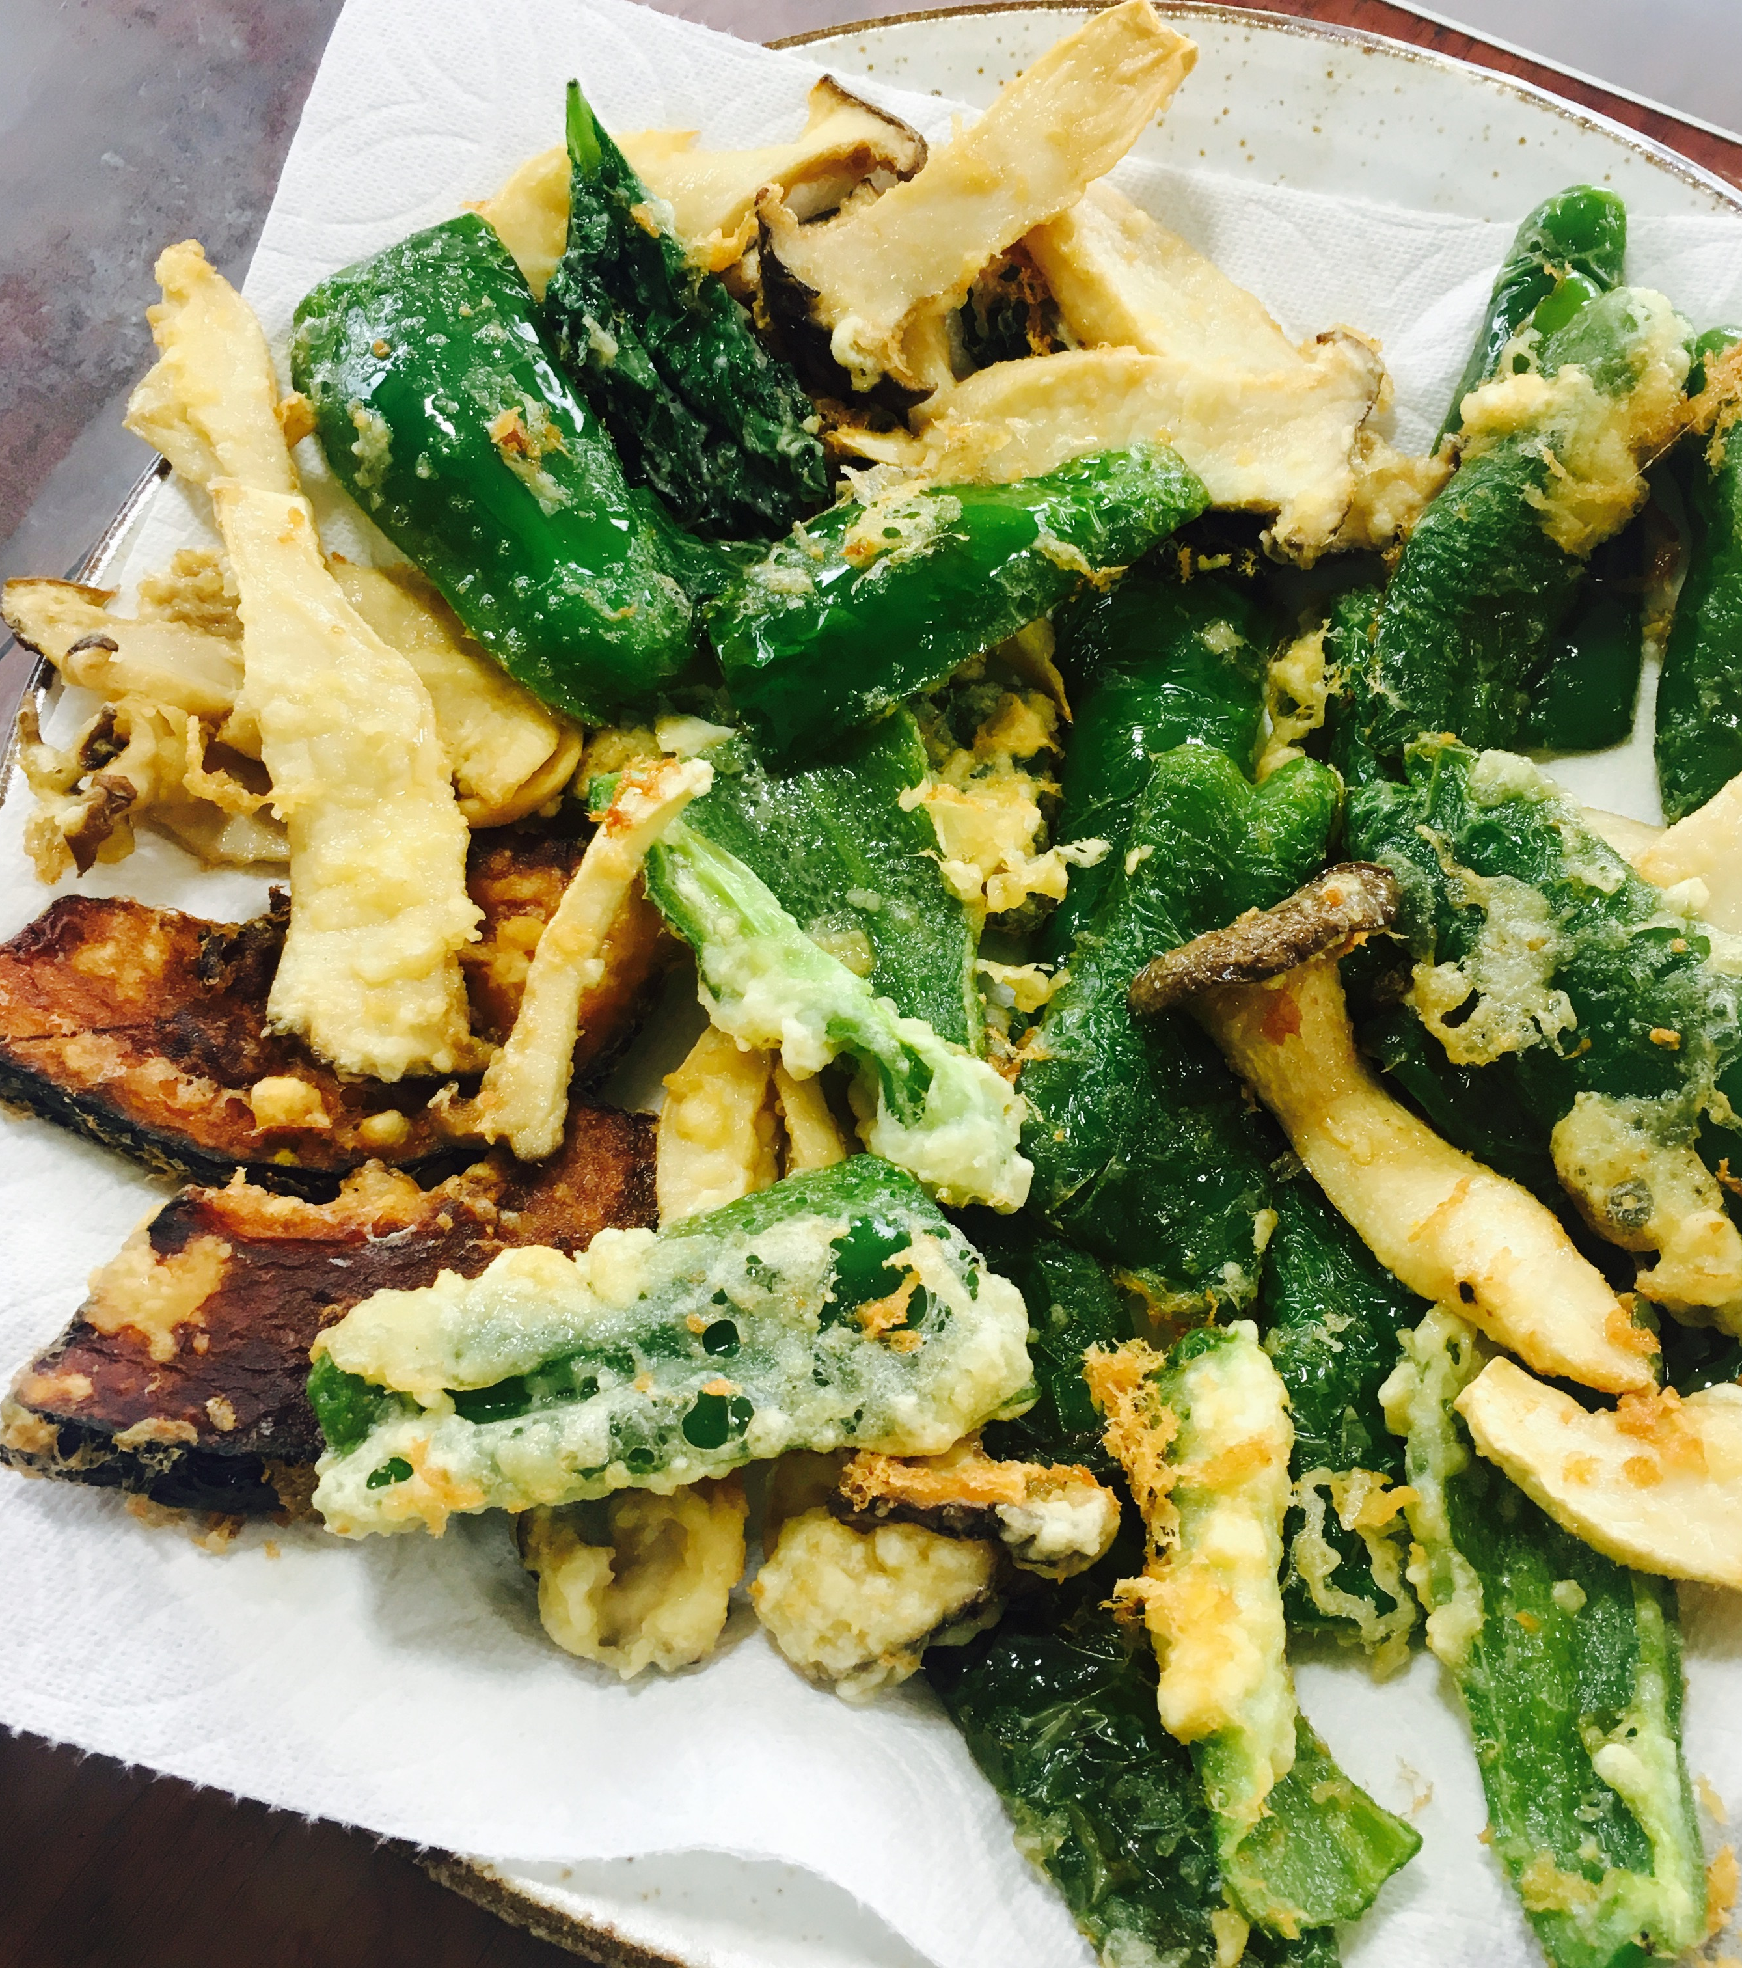
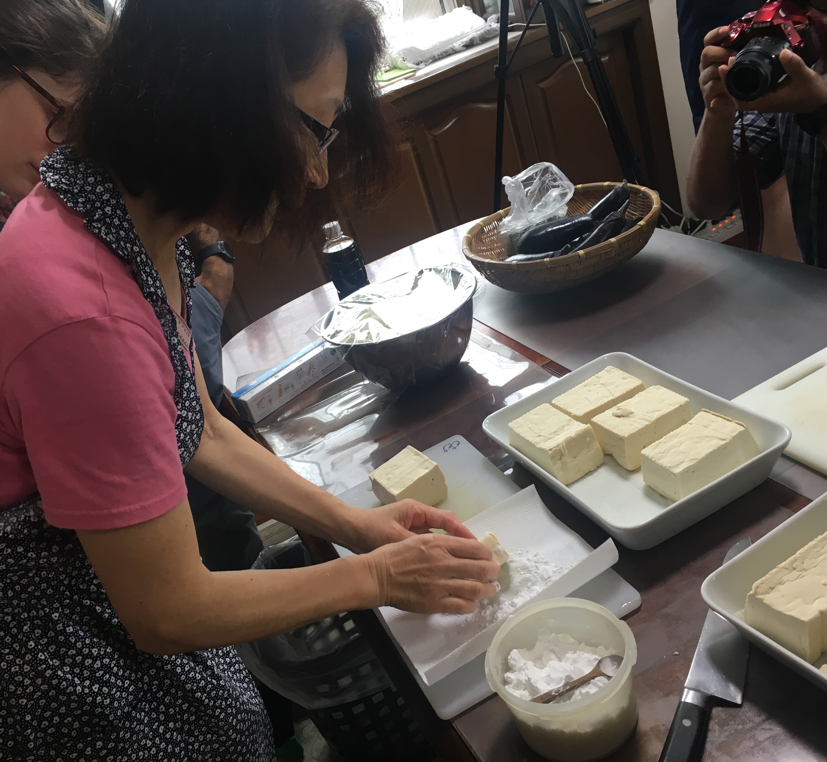
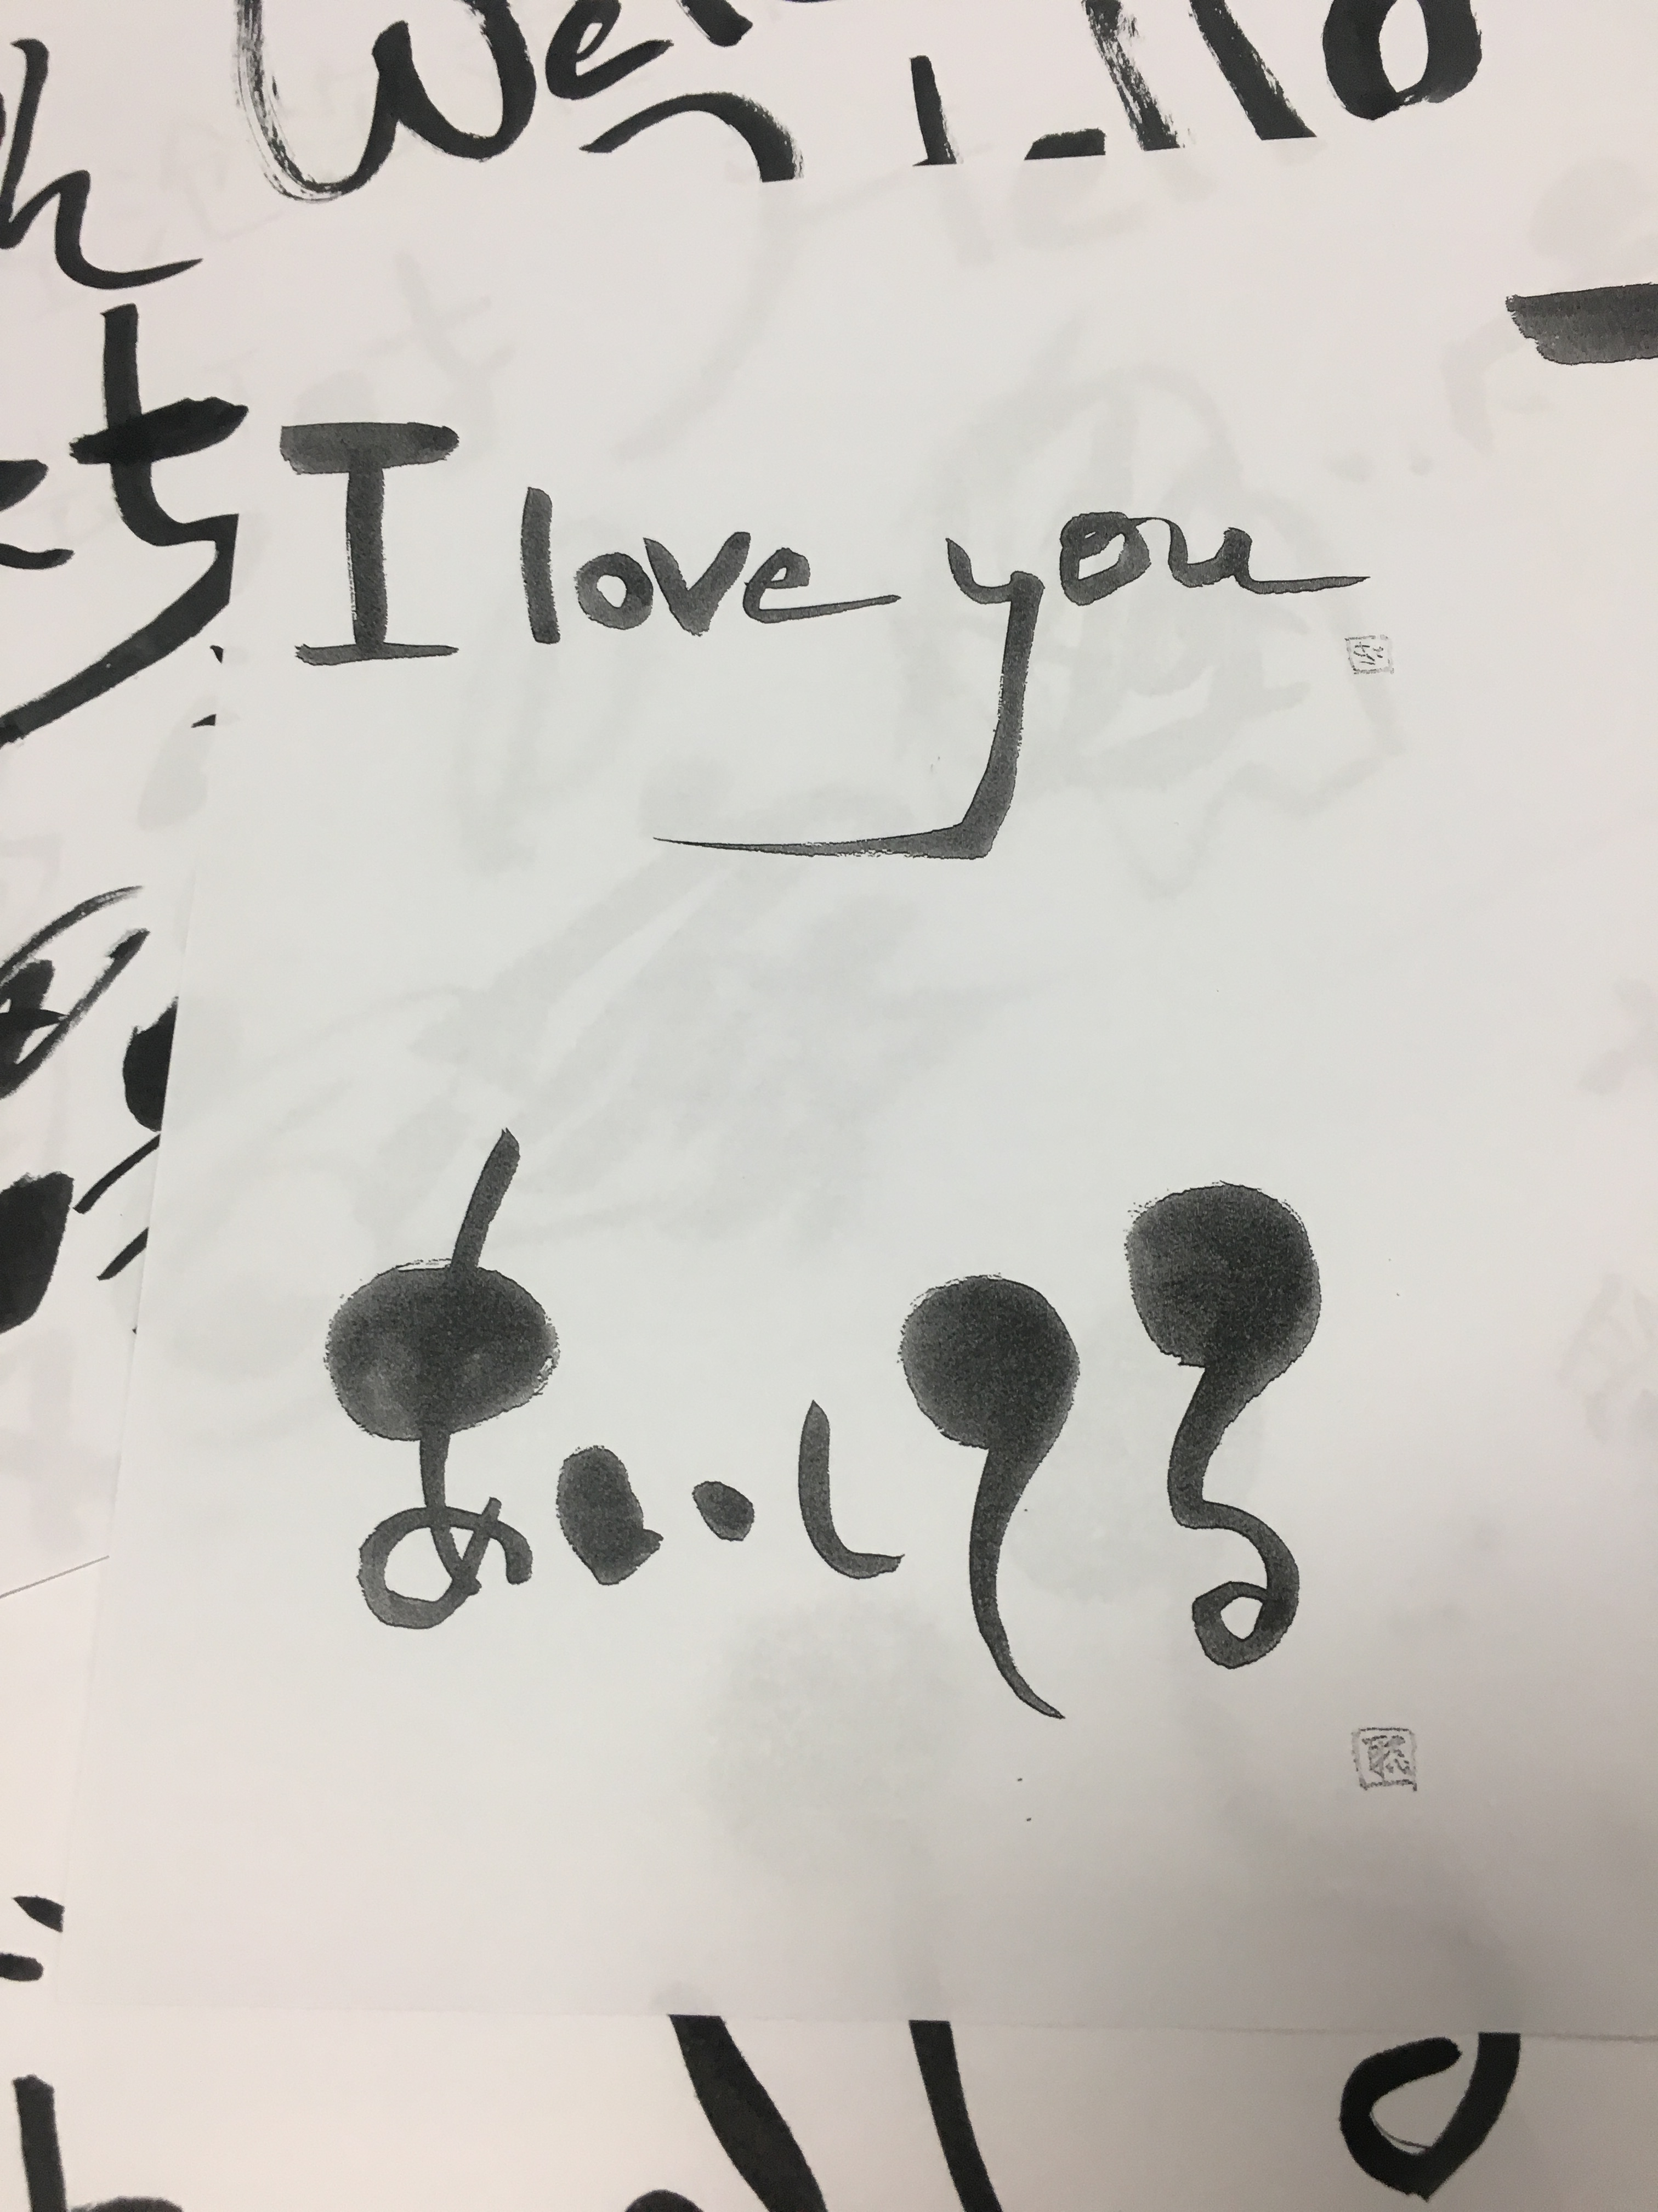
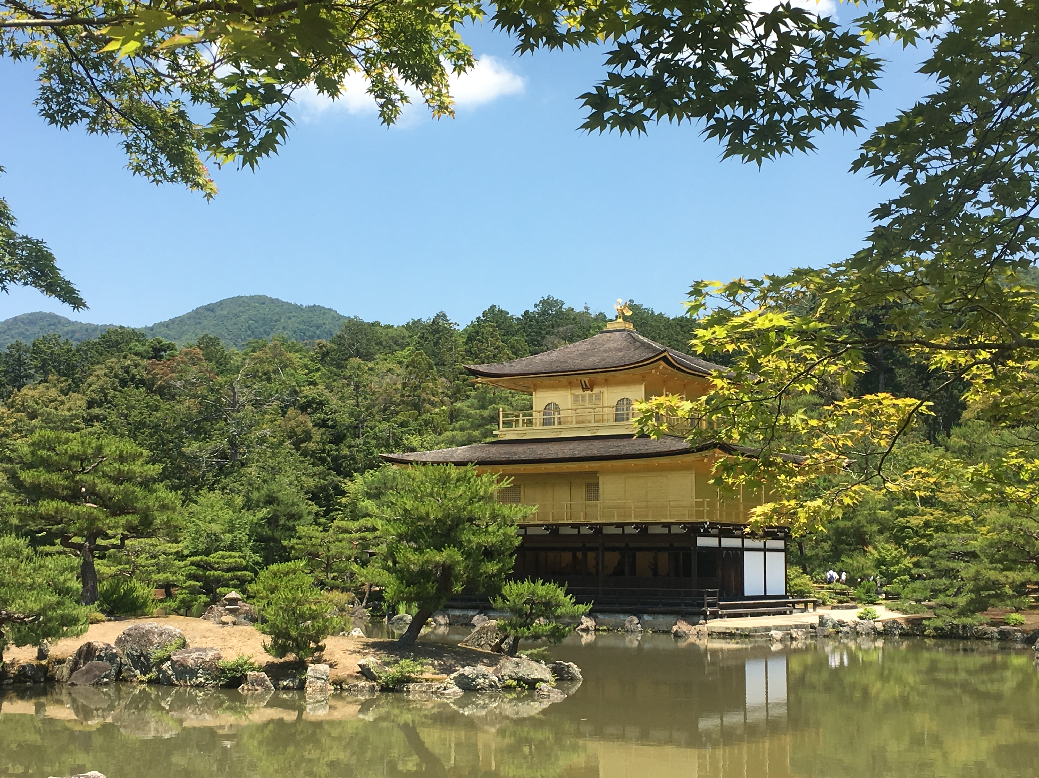
Why Summer Exchange? -Culture
Deep and Well-rounded Experience of a different culture
School excursions
Temples and museums in Kyoto, Nara, Tokyo
Clubs
Calligraphy
Sumo
Japanese cooking class

Slide 5
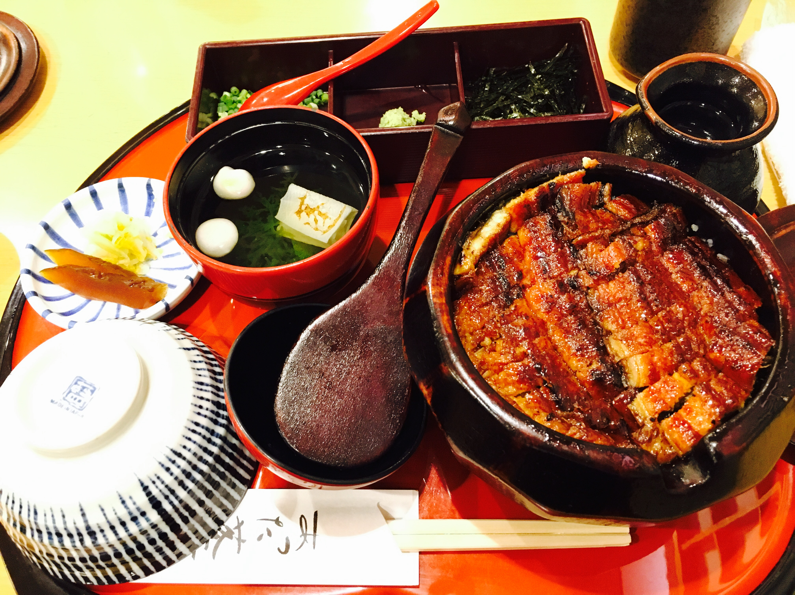
Why Summer Exchange? - Travel, Food and Friends
Go for a spur-of-the-moment trip on weekends
Enjoy traditional and local foods
Hang out with local students
Other students in the program from allover the world

Slide 6
Expense? No Worries
MIE Scholar
Japanese Scholar by the government

